Slide 1
EHS Management & design safety system course for project managers

Slide 2
Project EHS management system

Slide 3
Importance of safety, health and welfare
The foremost importance of workplace safety and health is to protect the safety, health and welfare of all concerned in the workplace. Poor workplace health and safety affects the individual, the workplace and the public. Some of the effects include:
accident, incidents, dangerous occurrences
injury, disease, death
changes to lifestyle
financial problems
psychological impact of injury/illness
low workplace morale
absenteeism
reduced or poor productivity
high compensation costs
company reputation and image issue

Slide 4
Compliance with legal and other requirements
Compliance with legal and other requirements is the key success in protecting safety, health and welfare of all stakeholders in the workplace. Compliance with respect to EHS include;
1. Factories Act & BOCW Act
2. Relevant subsidiary regulations and rules
3. Approved code of practices and standards
In addition, subsidiary legislation under the EHS related Acts and regulations including the following areas:
a. Risk Management: Employers are required to carry out safety and health risk assessments under the EHS (Risk Management) Regulations.
b. Reporting: All workplaces are required to report work-related accidents, dangerous occurrences and ODs under the EHS (Incident Reporting) Regulations.
c. Monitoring and Surveillance: Regulations are in place to ensure that the safety and health of workers is not compromised through regular inspection and surveillance of workplaces by authorities.

Slide 5
Improve company reputation
Preventing accidents and ill health at work bring companies a good reputation among stakeholders and society.
It's important that the company carry good name. Good reputation increase marketing and generate more leads.
If the company experiencing avoidable injury or accidents in the work environment, or continued employee ill health, it can cost you more than expected and the reputation issues include;
media damages
negative public opinion that is hard to reverse
penalties
negative sales
reduced profits and revenue.
It can take time to recover and get company business up and running again. But it's easy to prevent damage to health and safety reputation by implementing a simple and effective programme of control to manage the risks.

Slide 6
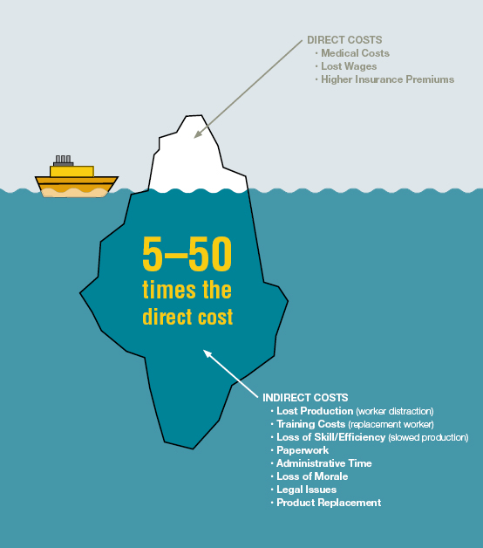
Boost profit
The cost benefit assesses the total costs of employment and the losses due to workplace injury or illness. Because it is specific to the organization, it is a better reflection of the actual economic benefits. An overview of the cost benefit model is shown in the flow diagram below. To boost the profit of the company, companies could avoid losses such as;
Direct cost: Accident compensation, Medical expenses, Leave pay, Work stoppage etc
Indirect cost: Insurance premium increase, Low morale, Company image loss and negative sales, Legal expenses, Re recruitment and training costs

Slide 7
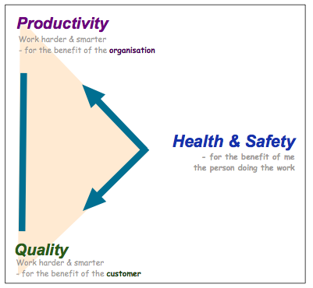
Improve productivity
A good workplace safety and health will improve the quality of workmanship which ultimately improve productivity.

Slide 8
Enhance morale
Morale in the workplace will be improved through a better EHS program planning and implementation.
Work-related stress is a major cause of ill health among employees. Prolonged periods of stress, have an adverse effect on health including:
Physical effects such as heart disease, back pain, headaches, gastrointestinal
disturbances or various minor illnesses; and
psychological effects such as anxiety and depression, loss of concentration and
poor decision making.
Stress can also lead to other behaviors that can have an adverse effect on psychological and physical health and wellbeing, for example, workplace violence, aggressive behavior, alcohol/drug abuse, eating disorders and working long hours.

Slide 9
Reduce accidents
Workplace safety and health implementation will reduce the accidents and incidents through;
Continued participation and commitment in EHS by management and stakeholders
identifying, analyzing and controlling new or existing hazards, conditions and operations;
communicating to all affected employees so they are informed of work-related hazards and controls;
workplace accidents should be investigated and corrective action implemented;
safe work practices and rules should be enforced.

Slide 10
Reduce damages and losses
Workplace safety and health implementation will reduce the damage to equipment, properties and materials due to;
Fire & Explosions
Structural failures
Chemical Exposures
Equipment failure due to unsafe practices
The cause of equipment damages could be minimized through effective EHS program implementation and continual improvement.

Slide 11
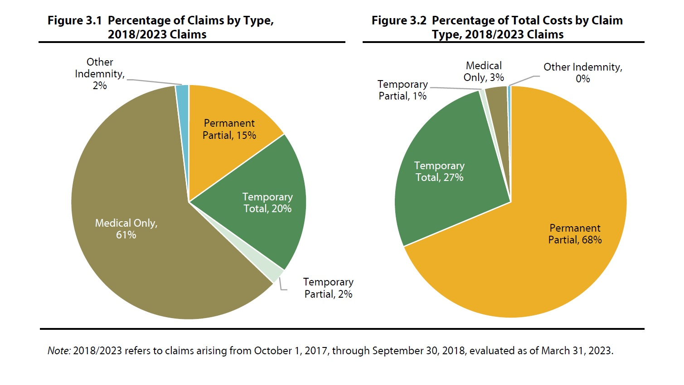
Reduce compensation claims
Compensation claims could be reduced through workplace safety and health programs.
A safety study showed a 9.4% drop in injury claims and a 26% average savings on workers' compensation costs in the four years between companies with and without EHS program implementation.

Slide 12
Reduce absenteeism
Reducing the incidence of absenteeism while developing and implementing EHS solutions to deal with absent employees. Absenteeism and EHS in a can become a vicious cycle. A company without a proper EHS program can be at greater risk for accidents, while on-the-job injury can result in higher levels of absenteeism, thus perpetuating the cycle. Companies without EHS programs also more susceptible to lost revenue through absenteeism-related reduced productivity than those companies practicing good EHS program.

Slide 13
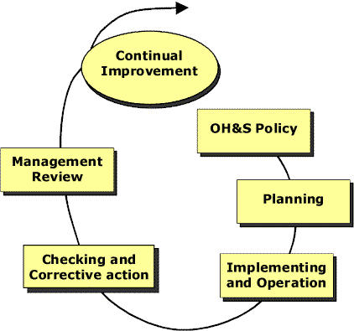
Operational EHS Management System
Key Management Strategy
Senior management’s commitment to the management of safety
Effective safety reporting
Continuous monitoring
Investigation of safety occurrences
Sharing safety lessons learned and best practices
Integration of safety training for operational personnel
Effective implementation of procedures (SOPs)
Continuous improvement of the overall level of safety

Slide 14
Elements in ISO 45001 SMS Model
CONTINUAL IMPROVEMENT
4.2 EHS Policy
4.3 Planning
EHS Aspects
Legal & Other Requirements
Objs, Targets & Programme(s)
4.6 Management Review
4.5 Checking
Monitoring & Measurement
Accidents, NCs, Corrective
Action & Preventive Action
Control of Records
Internal Audit
4.4 Implementation & Operation
Resources, Roles, Responsibility & Authority
Competence, Awareness & Training
Communication
Documentation
Control of Documents
Operational Control
Emergency Preparedness

Slide 15
Typical EHS Management System components include:
The vision statement: A vision statement is based on an organization's strategic and organizational objectives.
The mission statement: Tells the world why the company exists. It's purpose. What it does.
Objectives: Intended outcomes that support the mission and vision.
Policies: General guidance formulated and implemented by managers at all levels.
Programs: Describe coordinated strategies that support policy.
Plans: Give clear written (formal) guidelines on how to implement programs and policies.
Processes: Make sure safety is integrated into operational processes.
Procedures: Ensure concise formal/informal step-by-step instructions.
Budgets: Support investment in all of the above.
Reports: Reflect process and measures results. Evaluates effectiveness of all the above.
Rules: Clearly state specifications and performance standards.

Slide 16
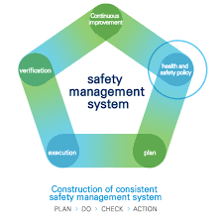
EHS Policy
Appropriate to the EHS risks
Commitment to prevent injury & ill health
Commitment to comply with legal & other requirements
Framework for establishing & reviewing EHS objectives
Documented, Implemented & Maintained
Communicated to all persons
Available to interested parties
Reviewed periodically

Slide 17
Planning
Hazard Identification, Risk assessment & Determining controls
Hazard Identification & Risk assessment shall take into account:
routine & non-routine activities
activities of all persons having access to the workplace (including sub-contractors & visitors)
hazards created in the vicinity of the workplace by work-related activities under the control of the organization
facilities at the workplace

Slide 18
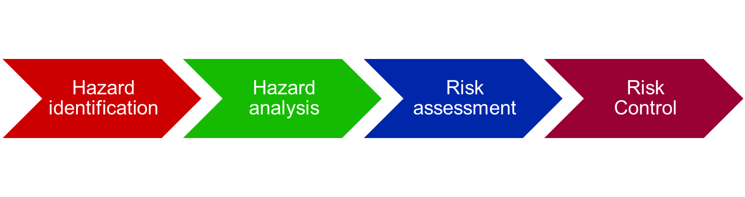
Risk Management – The achievement of Safety
Risk management is fundamental EHSSMS component for controlling risk to acceptable levels.
Risk management must identify hazard from design, procedures and operating practices, personnel factors, organizational factors, human performance, etc

Slide 19

Safety Promotion – The continuous improvement
The organization must continuously promote safety as a core value with practices that support a sound safety culture

Slide 20
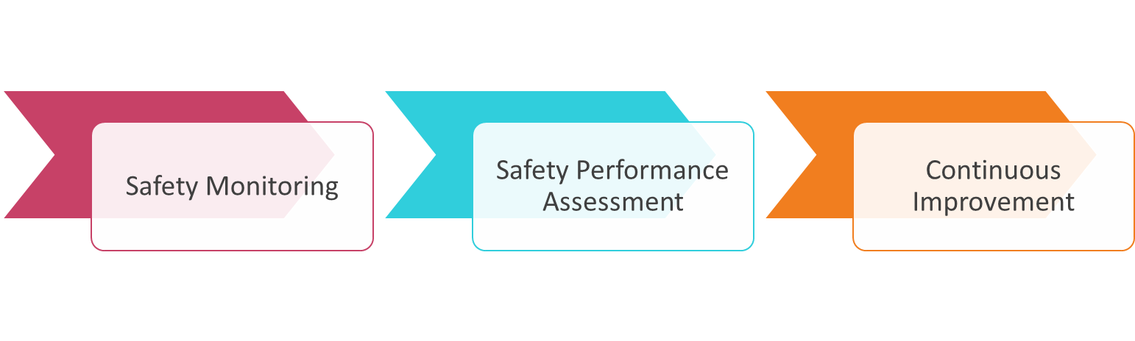
Safety Assurance – The continuous compliance
The organization must have the ability to be in control of the safety performance in order to assure that the EHSMS is effective

Slide 21
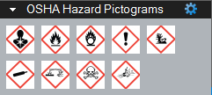
Broad categories of hazards:
Civil and Structural
Chemical
Mechanical
Electrical
Radiation
Ergonomics
Fire & Explosion

Slide 22

Examples of Civil and Structural hazards
Excavation
Piling
Scaffold/ ladders
Formworks
Working at height
Manual lifting
Mechanical lifting
Confined spaces

Slide 23
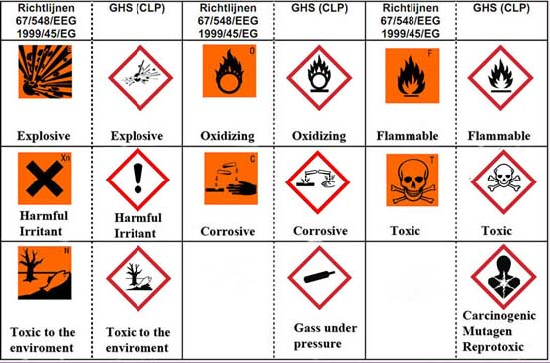
Examples of Chemical hazards:
Acidity or causticity
Flammability
Pyrophoricity
Thermal instability
Oxidizing or reducing ability
Toxicity

Slide 24
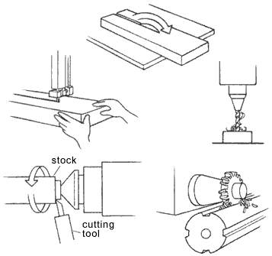
Examples of Mechanical hazards:
Sharp edges or points
Rotating Equipment
Weights to be lifted
Deceleration (Sudden stops, failure of brakes, etc)
Acceleration (Inadvertent motion, translation of loose object)
Stability / toppling tendency (Cranes, pallets, drums, etc)
Vibration (Vibrating tools, High noise level, Mental fatigue)

Slide 25
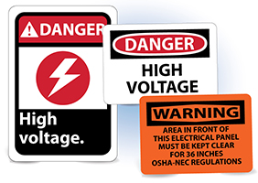
Examples of Electrical hazards:
Power trips/failure
Overheating
Burns
Inadvertent activation
Electrical shocks by using electricity

Slide 26

Examples of Radiation hazards:
Ionizing radiation (x-rays, gamma-rays, alpha & beta particles,
radioactive materials)
Non- ionizing radiation (ultraviolet, infrared, lasers, electro-
magnetic radiation

Slide 27

Examples of Ergonomics hazards:
Body postures
Equipment posture
Room temperature
Examples of Fire & Explosion hazards:
Natural (Lighting, earthquakes)
Internal ( Explosive gas, liquid or dust, Presence of strong
oxidizer, strong ignition source & fuel)

Slide 28
Hazard Identification, Risk assessment & Risk Controls
Identify hazards associated with
research activities
• Conduct risk assessment for all related
activities
• Develop control measures
• Implement control measures
Risk Assessment
Process of evaluating the risk arising from a hazard, taking into account the adequacy of any existing controls, & deciding whether or not the risk is acceptable

Slide 29
Selection of EHS Risk Control Measures
HIGHEST PRIORITY
Hazard Elimination
Substitution
Engineering Controls
Administrative Controls
LOWEST PRIORITY
Personal Protective Equipment
(PPE)

Slide 30

Legal & Other Requirements
Procedure to identify applicable legal & other requirements (Includes Customer’s
requirement)
Determine how these requirements apply to the EHS aspects
Keep this information up-to-date.
Communicate to all persons working under the control of the organization, & other
relevant parties.

Slide 31

Objectives & Management Programme(s)
Objectives
Establish, Implement & Maintain Documented EHS objectives
Shall be measurable & consistent with EHS Policy including:
commitments to the prevention of injury & ill health
compliance with applicable & other requirement
continual improvement
Reviewed periodically

Slide 32
Objectives & Management Programme(s)
Management Programme(s)
Establish and maintain programmes to achieve EHS objectives includes:
responsibility and authority for achievement at relevant functions and
means & time-frame
reviewed at regular & planned intervals

Slide 33
Implementation & Operation
Resources, roles, responsibility, accountability & authority
Top Management shall ensure availability of resources
Defining & allocating roles, responsibility & authority for HSEMS defined
Appointment & duties of Management Representative
Competence, Training & Awareness
Ensure that any one under its control performing tasks that can impact on EHS are
competent
Identify training needs, provide training
Evaluate effectiveness of the training
Retained all associated training records

Slide 34
Communication, Participation & Consultation
Communication
The organization shall establish, implement & maintain a procedure for:
internal and external communication on EHS issues
receiving, documenting & responding to relevant
communications from external interested parties
Participation & Consultation
Employee participation, involvement & consultation arrangements in HSEMS
issues shall be documented

Slide 35
Documentation
EHS Policy & Objectives
Description of scope, main elements & interaction
Documents & Records required by this OHSAS Standard
Documents & Records necessary to ensure effective planning, operation &
control of processes.

Slide 36
Documentation Structure
EHS Manual describing the core elements of the Management Systems
1st LEVEL
MANUAL
Procedures describing details of the systems, & include safety elements
2nd LEVEL
OPERATING PROCEDURE
3rd LEVEL
SUPPORT DOCUMENTATION
Procedures on details of “HOW” with safe work practices

Slide 37
Control of Documents
Establish, Implement & Maintain a procedure to:
approve documents prior to issue
review, update & re-approve documents
current revisions identified
Available at points of use
Legible & readily identifiable
Documents of external origin controlled
Remove obsolete documents

Slide 38
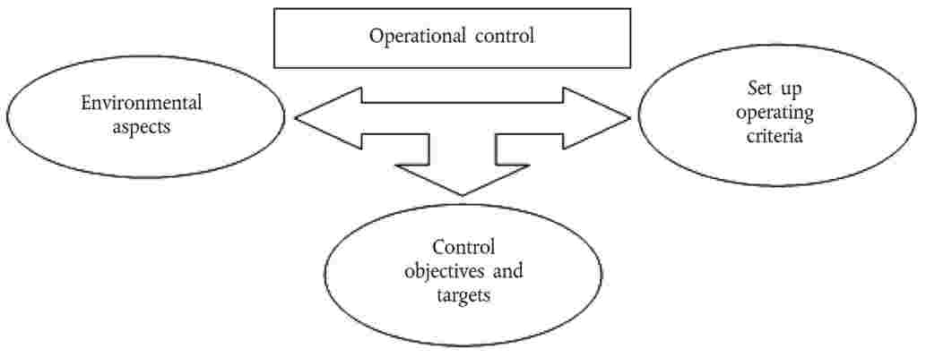
Operational Control
Identify operations & activities associated with identified risks where control
measures are required
Establish documented procedures for critical operations
Ensure activities including maintenance are under control
Communicate applicable procedures to suppliers and contractors when appropriate

Slide 39
Emergency Preparedness & Response
Procedures for incidents & emergencies
Identify potential for
Response to
prevent/mitigate associated illness & injury
Emergencies Plans & Procedures to be:
reviewed after an incident/emergency
periodically tested

Slide 40
Checking
Performance measurement & monitoring
Establish, Implement & Maintain a procedure to:
Monitor key characteristics of operations that have significant EHS impact
Information on performance, operational controls, and conformity to objectives
& targets
Proactive & Reactive monitoring
Monitoring equipment calibrated or verified

Slide 41
Evaluation of compliance
Establish, Implement & Maintain a procedure for:
Commitment to compliance
- Periodically evaluating compliance with applicable legal requirements
- Keep records of the results of the evaluations
Evaluate compliance with other requirements
- May combine this evaluation with the evaluation of legal compliance
- Keep records of the results of the evaluations

Slide 42
Incident investigation, nonconformity, corrective &
preventive action
Incident investigation
Establish, Implement & Maintain a procedure to record, investigate & analyze incidents:
determine deficiencies that cause occurrence of incidents
identify need & opportunities for corrective & preventive action
opportunities for continual improvement
communicate results of such investigations
Results shall be documented & maintained

Slide 43
Nonconformity, corrective & preventive action
Establish, Implement & Maintained procedure to:
Identify N/C, take actions to mitigate their impacts
Investigate, determine causes, prevent recurrence
Review effectiveness of action taken
Recording results of corrective and preventive actions

Slide 44
AUDITS & REVIEWS
During the phases of project design, procurement, EHS activities will be checked against the degree of effectiveness and efficiency of the System. Audits and Inspections will be performed according to “EHS Management System Manual”
The System performance monitoring processes seek demonstration that:
Standards, local and national legislation and contractual requirements have been established.
Coordination, communication and monitoring of HSE-sensitive activities have been put in place.

Slide 45
Data control
EHS related actions arising from reviews, lessons learned or from general discussions are captured, registered and tracked to completion by the Project EHS Manager.
Each action/issue has an assigned person responsible for closing the item as well as an anticipated date for completion.
The Project EHS Manager keeps trace of the reasons for significant decisions taken.
Significant support and collaboration in the collection of data is provided by each Discipline EHS Officer, HO Construction /Start-up EHS Manager and Site EHS Manager and by recording/filing and reporting activities.

Slide 46

INCIDENT REPORTING/INVESTIGATION
All manhours of NECL personnel on the Project are included in overall Corporate statistics. Manhours of Owner’s personnel in NECL offices are estimated and included in overall Corporate statistics.
All Accidents, incidents, environmental releases, near misses should be reported to HO and all these shall be investigated, analyzed and included in the EHS monthly / annual reports.

Slide 47
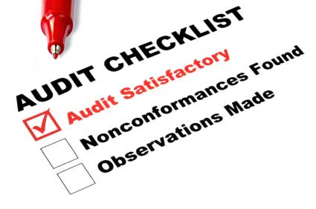
EHS AUDITS
Audits will be executed according to the Audit schedule prepared by the Project EHS Manager.
The activity of verification of performances addresses internal activities as well as external parties such us inspections, assessment or pre-qualification on vendors/ Subcontractors, as required by project needs. A EHS audit schedule is issued for execution and reports the timing of audits for involved project area.
Internal Audits
The Project EHS Manager conducts the head office audits covering the area as here listed:
Human Resources and Logistic
Process Design
Engineer Design
Construction
Start-up and Training.
In particular the safety audits on Design activity will cover:
assessment of effectiveness of EHS reviews;
the verification of the implementation of their results in the Plant design;

Slide 48
MANAGEMENT REVIEWS
The purpose of the management review is to assess the effectiveness and efficiency of the Project EHS System.
Senior management meetings are scheduled to contain agenda items relating to EHS activities. The meeting will address Project EHS trends and implement corrective actions as appropriate.

Slide 49
Environmental Management System

Slide 50

Environment protection and waste management
Planning Control of New Facilities
The impact of all developments on the environment is assessed and considered before each development is allowed to proceed. PCD checks these proposals, assesses the impact on the environment and ensures that project developments are properly sited and are compatible with the surrounding land use. It also processes building plans and assesses the environmental impact to ensure that the prospective industries will not pose unmanageable health and safety hazards, and pollution problems.
Water Pollution Control
All wastewater (trade effluence) from construction and operation facilities must be discharged into the public sewerage system , or to a watercourse if the public sewer is not available. A permit must be applied for such discharge.
Notes:
Trade effluence must be treated to the specified standards before discharge into a sewer. These standards, together with other requirements are set out in the Sewerage and Drainage Act and Sewerage and Drainage (Trade Effluent) Regulations and are administered by PUB. (If the public sewer is not available, trade effluence must be treated to standards specified in the Environmental Pollution Management (Trade Effluence) Regulations, which is administered by the Pollution Control Department, National Environmental Agency.)
Premises generating large quantities of acidic effluent are required to install a pH monitoring and shutoff control system to prevent the discharge of acidic effluent into the public sewer.

Slide 51
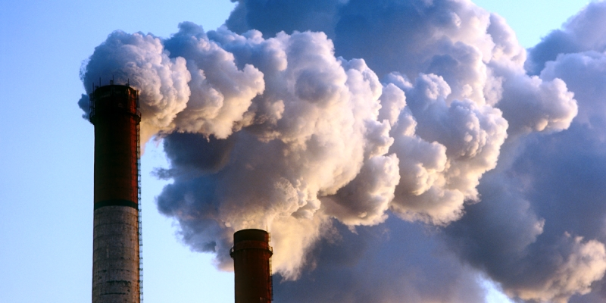
Environment protection and waste management
Air Pollution Control
Projects equipped with pollution control equipment (such as diesel boilers, furnaces etc.) must comply with the air emission standards. The air emission standards are specified in the Environmental Protection and Management (Air Impurities) Regulations of specific countries.
To minimise the emission of sulphur dioxide into the air, the sulphur content in fuels (such as diesel) used by industries is limited to not more than 1% by weight.
The use of open fires to dispose wastes is prohibited under the Environmental Pollution Control Provisions of specific country standards.
Hazardous Substances Control
The control of hazardous substances is governed by the respective Environmental Protection Regulations.
Notes:
Shipyards can apply to PUB for permission to discharge their trade effluent containing biodegradable pollutants, as determined by their biochemical oxygen demand (BOD) and total suspended solids (TSS) loading exceeding the allowable standards, directly into the public sewers on payment of a tariff. The tariff is levied to recover the costs incurred in treating the additional pollution load at the sewage treatment works.
The provision, operation and maintenance of sewerage system are governed by the Sewerage and Drainage Act (SDA). The treatment and discharge of industrial wastewater into public sewers are regulated by the SDA. The Sewerage and Drainage Act its subsidiary regulations are administered by PUB.
A licence is required for any person who wishes to import, sell, export, purchase, store, and / or use any hazardous substance controlled under the Act. A permit is required for any person who wishes to purchase, store and / or use any hazardous substance controlled under the Environmental Protection and Management (Hazardous Substances) Regulations.
Ozone Depleting Substances (ODS) are controlled as hazardous substances under the Environmental Pollution Control Act. Control of ODS covers the import, export, production and consumption and is regulated under the Environmental Protection and Management (Ozone Depleting Substances) Regulations.

Slide 52
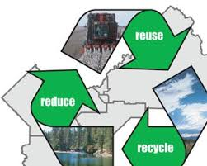
General Waste Disposal
Projects should implement good waste control and management practices. Options available for the handling and treatment of waste include:
· Reduce (most preferred)
· Reuse
· Recycle
· Disposal (most preferred)
Organisations should systematically review their waste generation to identify the opportunities for waste minimisation.
The most ideal approach is to minimise waste generation in the first place.
Whenever possible, materials should be considered for reuse so as to minimise wastage.
If reuse is not possible, the next best option would be to recycle the waste.
This usually involves selling the waste as scrap to recyclers, who reprocess the scrap material into other forms or products.
Where the above is not possible, waste should be properly disposed in accordance with the applicable legislations.
Notes:
The disposal of waste is governed mainly by the following legislation:
• Environmental Public Health Act Makes provisions for environmental pollution issues likely to be caused by general public, including waste management and cleanliness in public places.
• Environmental Public Health (General Waste Collection) Regulations
Sets requirements pertaining to the generation, storage, handling, transport and disposal of general waste, waste from grease interceptors, waste from sewerage systems, and waste from sanitary conveniences that are not part of a sewerage system.
• Environmental Public Health (Toxic Industrial Waste) Regulations
As described in the following paragraph on Toxic Industrial Waste Control.
• Radiation Protection Act
Regulates, among other aspects of radiation protection, the disposal of radioactive materials and irradiating apparatus.
• Hazardous Waste (Control of Export, Import and Transit) Act and subsidiary legislations Sets the requirements for controlling the movement or trans-boundary movement of hazardous waste in, through, and out of Singapore.
• Code of Practice on Pollution Provides, among other aspects of pollution control, guidelines for toxic industrial waste.

Slide 53
Environment protection and waste management
Toxic Industrial Waste Control
For toxic industrial waste (TIW) generators, the requirements on control measures, that contains the following information:
- Types and quantities generated;
- Manner of disposal;
- Date and quantity supplied or sold to a toxic industrial waste collector;
- Name and address of the toxic industrial waste collector; and
- Quantity held in stock.
Storing TIW in containers with design, construction and maintenance in accordance with approved code of practice and labelled with appropriate hazard warning signs;
Prohibiting the mixing of different types of TIW, or mixing of TIW with non-TIW are prohibited;
• Selling or supply to licensed collector only;
• Supplying accurate information about the TIW to the TIW collectors;
• Preparing and keeping up-to-date the emergency action plan detailing how spillage, leakage or accidents involving the TIW will be dealt with.
Notes:
The management of toxic wastes in Singapore is under the purview of the Pollution Control Department and is carried out through the Environmental Public Health (Toxic Industrial Waste) Regulations 1988. It makes provisions for the requirements for the generation, storage, handling, transportation and disposal of general waste; waste from grease interceptors sewerage systems and sanitary conveniences that are not part of a sewerage system.
The types of toxic waste which are controlled are listed in the Schedule of the Environmental Public Health (Toxic Industrial Waste) Regulations. Example of toxic industrial waste generated in shipyards include: waste oil, spent solvents, spent waste acids / alkalis and waste sludges etc.
Storing and dealing with TIW in a manner not to threaten the safety and health of any person or cause pollution to the environment;

Slide 54
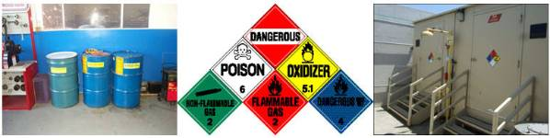
Waste Classification
Definition: Industrial waste classification is made in based on various types of waste. These are;
Wastewater
Air emission
Solid waste
Hazardous waste
Bio waste
Radioactive waste
Sludge & Slurry

Slide 55
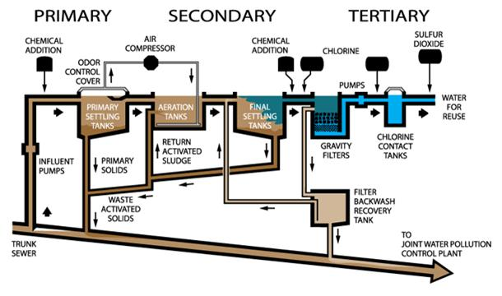
Sewage control
Septic tank system
Wastewater or sewage treatment plants
Primary sewage treatment
Physical process
Secondary sewage treatment
Biological process
Tertiary or advance sewage treatment
Bleaching, chlorination

Slide 56
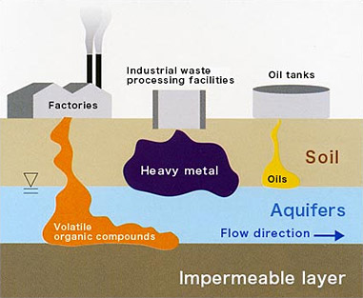
reducing Soil pollution
Minimize water wastes
Filtering system for storm water and waste water
Not to connect directly waste water into public pond, river, sea without treatment
Soil wastes should be disposed for treatment

Slide 57
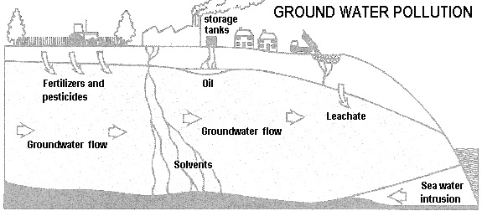
Groundwater Pollution Prevention
Find less hazardous substitutes
Leak detection systems
Strictly regulating hazardous waste disposal
Store hazardous materials above ground

Slide 58
Engineering and design based EHS management system

Slide 59
Scope
The plan provides:
Reference to main HSE-related requirements, standards and procedures, which form the basis of the work carried out.
Reference to measures adopted for the management of the HSE-risks associated to the activities in the scope of work.
Information to the project team, clients, and third parties on the management and administration of EHS, throughout all stages of the project.
A means for controlling the performance of the work from a EHS perspective.
Description of roles and responsibilities.

Slide 60
LEADERSHIP & COMMITTMENT
1.SUSTAINABLE DEVELOPMENT
NECL consider Sustainable Development as an essential element in the corporate’s asset and an overall concept that includes:
The implementation of the requirements of Corporate Social Responsibility (CSR Management System).
The activities regarding the safeguard of health of people, the prevention of incidents and the protection of the natural Environment (EHS Management System).
2.CSR MANAGEMENT SYSTEM
In compliance with the procedures of its Corporate Social Responsibility (CSR) Management System already operating according SA 8000 standard, NECL confirms its commitment to fundamental values such as Human and Worker’s Rights. In particular a special procedure for supply chain (suppliers and subcontractors) assessment of the organization will be followed through a evaluation to satisfy the requirements of SA 8000, supplementing existing procedures on vendor assessment and selection according to their ability to satisfy expectations on EHS and Quality.

Slide 61
LEADERSHIP & COMMITTMENT
3. EHS MANAGEMENT SYSTEM
The EHS Management System includes Health and Environment together with Safety
for its scope of the work and in compliance with the Owner’s requirements reported in the contractual document.
The system has been tailored in accordance with EHS Management System according to OHSAS 18001:2007/ ISO 45001 and ISO 14001:2004 requirements.

Slide 62
Hse POLICY & OBJECTIVES
EHS POLICY
NECL EHS Policy is declared in the Policy Statement on Health Safety & Environment manual and is the fundamental of this plan and its implementation for the Project.
The expressed intent in the policy is to consider EHS as NECL Project values not subject to compromise.

Slide 63
EHS Philosophy: INTEGRATED CONTROL & SAFETY SYSTEM (ICSS)
The Integrated Control & Safety System shall continuously monitor and control the plant during start-up, normal operation, reduced rate operation, upsets, and emergency shutdown.
The automation systems of the new and revamped Units will be based on several monitoring, control and safety functions in an Integrated Control and Safety System (ICSS).
The ICSS shall include the following main systems:
Distributed Control System (DCS) - Provides primary process control, monitoring, and data acquisition functions for the plant.
Safety Instrumented System (SIS) including Emergency Shutdown System (ESD) and Burner Management System (BMS) - Provides protection of personnel, environment, and equipment, through detection and actuation of devices designed to lead the plant into a safe condition.
Fire and Gas Detection System (F&G) - Provides local and centralized warning to personnel to handle the fire and gas events, through detection of fire or gas leakage in the field.

Slide 64
GOALS, TARGETS & PERFORMANCE STANDARDS
Goals
The overall Project EHS goals are to ensure excellence in EHS performance and they are summarized as “The Zeros”:
ZERO Engineering & Design failures
ZERO Injuries
ZERO Occupational Illnesses
ZERO Releases or spills to the Environment
ZERO Adverse impact to the Community
ZERO Process Incidents.

Slide 65
GOALS, TARGETS & PERFORMANCE STANDARDS
Rules compliance.
1. When requirements are in conflict the most stringent shall apply.
2. Any deviation from requirements shall be evaluated.
a. Risk assessment
1. Probability reducing measures are to be given priority over consequence reducing measures whenever possible.
2. The safeguarding priority criterion:
a. Safeguarding of personnel,

Slide 66
GOALS, TARGETS & PERFORMANCE STANDARDS
b. Safeguarding of the environment,
c. Safeguarding of plant.
3. The risk priority criterion is:
a. Design out the hazard:
Change technology or use less hazardous substances.
Segregation by plant and units from normally manned areas, buildings, safety critical equipment, 3rd parties.
Elimination of ignition sources.

Slide 67
GOALS, TARGETS & PERFORMANCE STANDARDS
b. Control the hazard by technical solutions:
Inherent safety.
No single failure or operator error lead to catastrophic event.
Barriers preventing development of incidents/accidents.
Minimization at source of air emissions: CO2, CO, NOx, CH4, nmVOC, H2S, SOx and particles.
Minimization of wastes.
ventilate enclosed spaces to reduce gas concentrations.

Slide 68
GOALS, TARGETS & PERFORMANCE STANDARDS
c. Control the hazard by organizational means:
d. Reduce the consequences:
Barriers limiting consequences of incidents/accidents.
Reduction of flammable inventory.
e. Establish the list of prohibited chemicals.

Slide 69
GOALS, TARGETS & PERFORMANCE STANDARDS
Communication
Operational instructions and specified operator training.
Resources assessment.
1. The assignment of duties on the basis of personnel’s skills, experience and health conditions.
2. Water management
3. Energy optimization.
4. Emergency facilities allocation.
Responsibility
1. Responsibilities are proportional to the power.
2. Everyone is in charge to stop the work if any risk may arise.

Slide 70
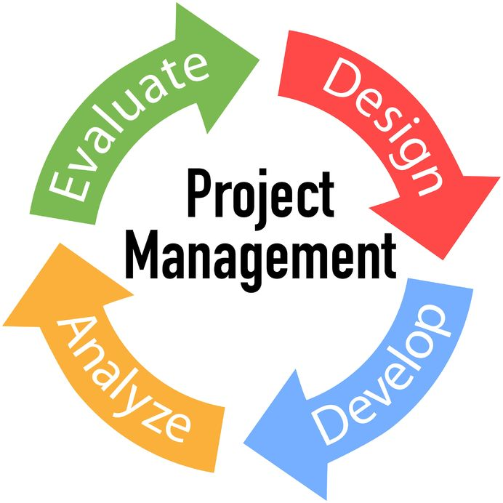
ORGANIZATION RESOURCES AND COMMUNICATION
Project Director/Manager
EHS Committee
Site Manager
EHS Manager
Discipline Managers
Sub Contractors
Vendors
Employees

Slide 71
EHS Management at corporate office
Write Project design philosophies for individual project and set targets & KPI’s
Prepare manuals and procedures for contractors for site implementation
Legal compliances
Complying Clients country specific regulatory requirements, standards, codes
Complying international codes and standards
Site verifications and audits
Accident and incident investigations related to engineering deviations

Slide 72
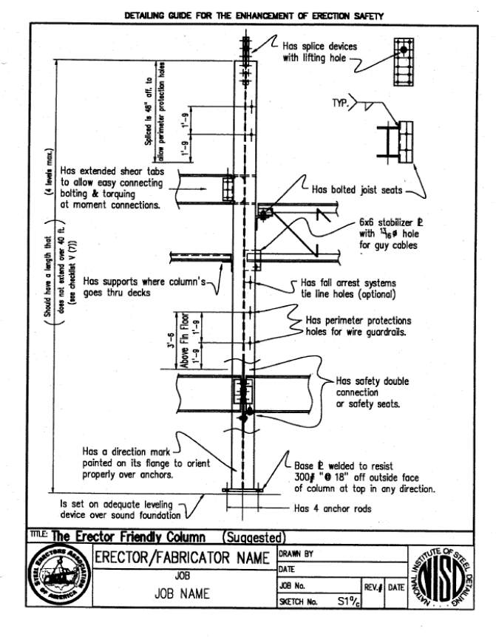
Prevention through Design
“Addressing EHS needs in the design process to prevent or minimize the work-related hazards and risks associated with the engineering, construction, use, maintenance, and disposal of facilities, materials, and equipment.”
Example: Steel Design
Avoid hanging connections; design to bear on columns instead using safety seats
Require holes in columns for tie lines 21” and 42” above each floor slab
Specify shop welded connections instead of bolts or field welds to avoid dangerous positions during erection
Consider approximate dimensions of connection tools to prevent pinches or awkward assemblies

Slide 73
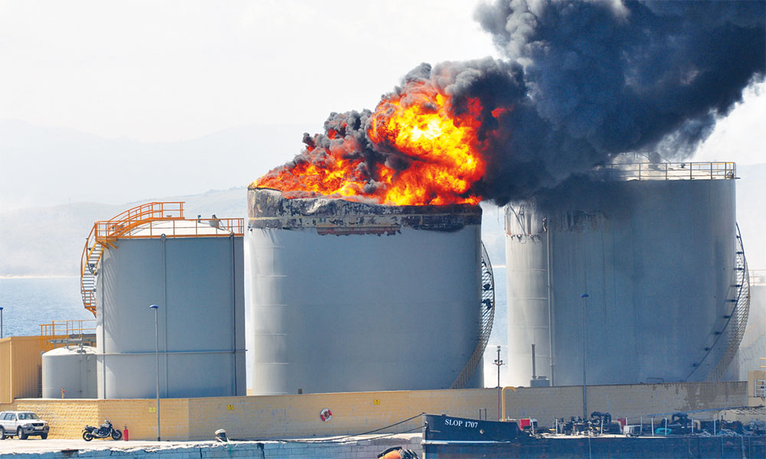
Accidents Linked to Design
22% injuries that occurred in EPC
42% fatalities in EPC related accidents

Slide 74
Considering Safety During Design Offers the Most Payoff
High
Conceptual Design
Detailed Engineering
Ability to Influence Safety
Procurement
Construction
Start-up
Low
Project Schedule

Slide 75
Sustainability
Environmental Equity
Sustainability
Economic Equity
Social Equity

Slide 76

Sustainability’s Social Equity Pillar
Do not our duties include minimizing all risks that we have control over?
Is it ethical to create designs that are not as safe as they could (practically) be?

Slide 77
Benefits of Safety by Design
Reduced site hazards → fewer injuries and fatalities
Reduced insurance compensation premiums
Increased productivity
Fewer delays due to accidents during construction allow continued focus on quality
Encourages designer-constructor collaboration

Slide 78
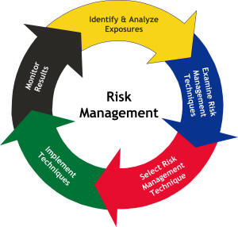
DESIGNING PLANT TO CONTROL RISK
The safe design of plant is usually a repetitive process. After the initial control measures are incorporated into the design, the design should be reviewed to determine whether there are remaining risks and whether redesign can eliminate or minimise these risks.

Slide 79
plant functions and limits
Plant limitations | Examples
Use | Intended use, production rates, cycle times and working load limits
Space | Range of movement and access for maintenance
Time | Wear and tear of materials and use of fluids
Environment | Temperature, humidity, noise and location
Interface | Other plant, energy sources and user interface
Technology | Intuitive decision making and visual stimulus overload

Slide 80
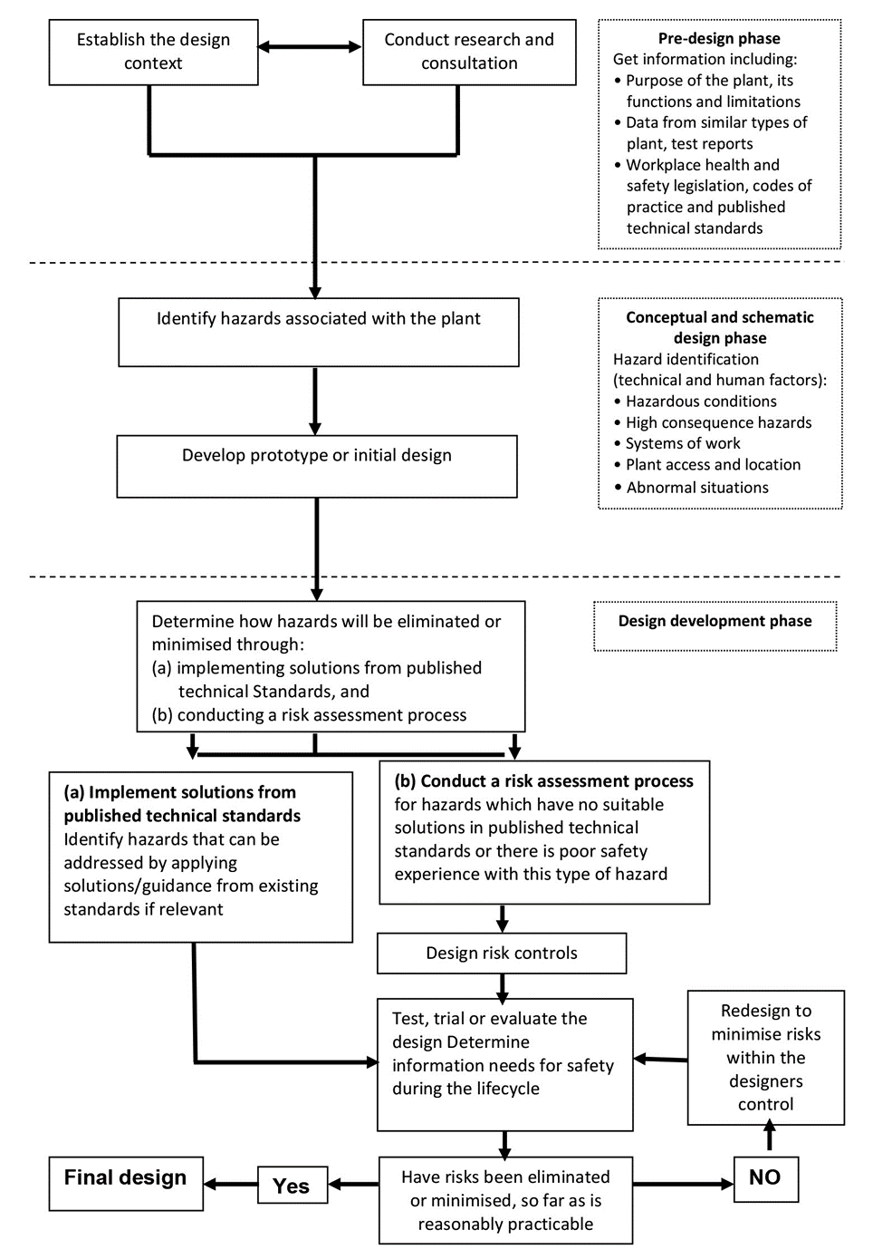
integrating design and risk management

Slide 81

Identifying the hazards
The first step in the risk management process is to identify all hazards. Hazard identification should be done as early as possible in the concept development and design phases. This involves finding the things and situations that could potentially cause harm to people throughout the plant’s lifecycle and the reasonably foreseeable hazards associated with each activity.

Slide 82
Things to consider to identify plant hazards
Things to consider to identify plant hazards
Hazards | Can the plant cause injury from entanglement, crushing, trapping, cutting, stabbing, puncturing, shearing, abrasion, tearing or stretching?
 | Can the plant create hazardous conditions from pressurised content, electricity, noise, radiation, friction, vibration, fire, explosion, temperature, moisture, vapour, gases, dust, ice, hot or cold parts?
 | Can the plant cause injury from lack of guarding of moving parts?
 | Can the plant cause injury as a result of unexpected start-up?
 | Can the plant cause injury or ill health from poor ergonomic design?
Suitability | Is the plant fit for its intended purpose? What is likely to happen if it is used for a purpose other than the intended purpose?
 | Are the materials used to make the plant suitable?
 | Are plant accessories fit for their intended purpose?
 | Is the plant stable? Could it roll over?
 | If the plant is intended to lift and move people, equipment or materials, is it capable of doing this?

Slide 83
Things to consider to identify plant hazards
Access | Is access to the plant necessary when installing, using and maintaining the plant or in an emergency?
 | Can workers access the plant safely without being injured by the plant or the risk of slips, trips and falls e.g. a walkway, gantry, elevated work platform or fixed ladder?
Location | Does the plant affect the safety of the area where it will be located e.g. what is its impact on the design and layout of the workplace? Does the location affect the safety of the plant e.g. environmental conditions, terrain and work area? Will there be people or other plant nearby? What effect would this have?
Systems of work | Do the systems of work for the plant create hazards?
 | Does the plant’s safety depend on the competency of its users?
 | Have users and others working near the plant received relevant training, information, instruction and supervision needed to ensure they are safe?
Unusual situations | What unusual situations or misuse could occur?
 | What would happen if the plant failed? Would it result in loss of contents, loss of load, unintended ejection of work pieces, explosion, fragmentation or collapse of parts?
 | Is it possible for the plant to move or be operated accidently?

Slide 84
Things to consider to identify plant hazards
Potential hazards | Phases of the plant lifecycle
mechanical e.g. crushing, cutting, trapping, shearing and high pressure fluids electrical thermal noise vibration radiation hazardous chemicals slipping, tripping and falling manual handling confined spaces environmental conditions, and hazards resulting from a combination of the above. | manufacture storage packing and transportation unloading and unpacking assembly installing commissioning using cleaning and adjustment inspection planned and unplanned maintenance or repair decommissioning dismantling, and disposal and recycling.

Slide 85
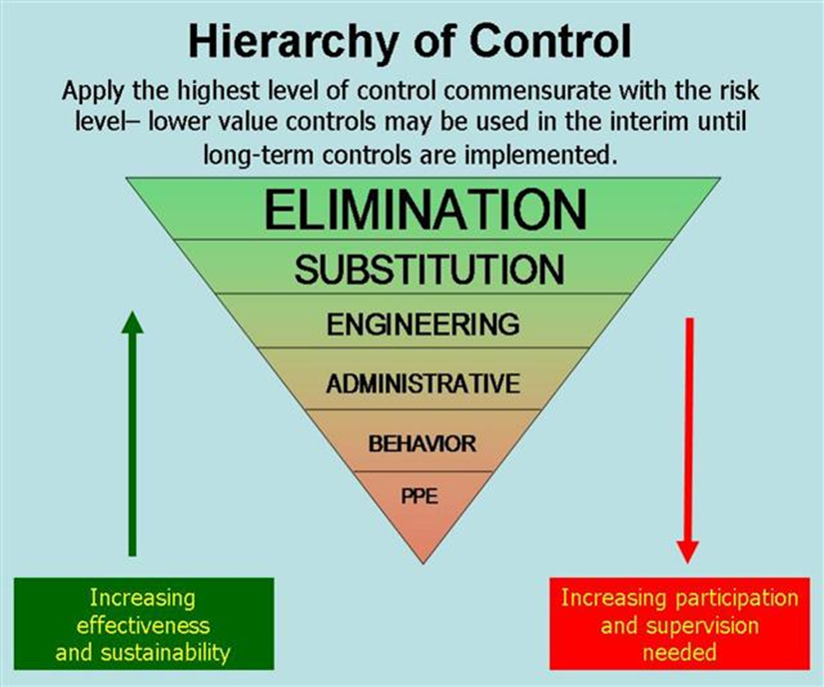
Assessing and controlling risks
A risk assessment involves considering what could happen if someone is exposed to a hazard and the likelihood of it happening.
Risk ranking is known as the hierarchy of risk controls.
Elimination is the most effective control measure.
If eliminating the risk is not practicable, you must consider using substitution, isolation or engineering controls, or a combination of these control measures, to minimise the risk.

Slide 86
Managing the risks
Design phase
The design phase may involve:
developing a prototype or initial design
testing, trialling or evaluating the prototype or design
redesigning to control any remaining risks, so far as is reasonably practicable, and
finalising the design and preparing risk control plans for the lifecycle of the product.
Technical standards
A plant designer may use technical standards or a combination of standards and engineering principles relevant to the design requirements as long as the design meets regulatory requirements.

Slide 87
Managing the risks
Testing and examining plant
Analysis, testing or examination that may be necessary to ensure, that the plant is designed without risks to people’s health and safety .
Testing may include developing a prototype to:
simulate the normal range of operational capabilities
test design features to ensure ‘fail safe’ operation
measure imposed stresses on critical components to ensure maximum design stresses are not exceeded
test critical safety features like over-speed and over-pressure devices under both normal and adverse operational conditions, and
develop overload testing procedures to ensure plant safety when plant is misused.
Records of tests and examinations must be maintained by the designer.

Slide 88
IMPLEMENTATION AND MONITORING - DESIGN PHASE
1. PLANT AND FACILITIES LOCATION
Several studies and analyses are performed to assure facilities location takes into account EHS risks, requirements and local peculiarities.
Requirements Compliance
Any impact on plot plan coming from standards and regulation or recommendations from the Environmental Impact Assessment are highlighted and taken into account. Implementation of regulations is checked.
Quantitative risk assessment
The Quantitative Risk Assessment (QRA) is a study to evaluate risks during the production, the use and the storage of hazardous substances for personnel inside the Site and for members of the public beyond the site boundary.

Slide 89
PROCESS safety DESIGN
Process Safety Design Criteria
The Process Safety Design Criteria is the collection of the minimum requirements regarding:
Process Safety Systems (ESD, Isolation & depressurization) in accordance with API standards, establishing a hierarchy criterion on the magnitude of shut down and pressurization.
Hazardous Area Classification, establishing criterion on elimination of ignition sources.
Passive and Active Fire Protection.
Fire & Gas detection System.
Personnel Safety.

Slide 90
PROCESS safety DESIGN
Environmental Design Philosophy
The Environmental Design Philosophy is the collection of criteria and philosophies and a reference document to provide guidelines for the technical specifications of engineering disciplines regarding:
The flaring policy, such us no production/continuous flaring expect for emergency reason.
The environmental monitoring requirements, such us use of Low NOx burners.
The minimization of fugitive emissions from sources.
The hazardous material handling.
The waste disposal policy.
The precautions against accidental spills.
The containment and clean up of spills.

Slide 91
PROCESS safety DESIGN
The following is a list of prohibited chemicals which need to be considered at design stage;
a. Brominated flame retardants.
b. Endocrine disrupters.
c. Ozone Depleting Substances.
d. e. PerFluorAlkyl Substances and PerFluorOctanylSulphonat Substances.
f. Hazardous Chemicals Rotterdam Convention.
g. Persistent Organic Pollutants Stockholm Convention.
h. Persistent Organic Pollutants UN Convention

Slide 92
PROCESS safety DESIGN
Fire Protection System
The active Fire Protection is an emergency allocation of resources, required to deal with an unexpected fire.
Fire prevention measures,
Fire water and foam supply systems,
General purpose fire protection facilities,
Dedicated purpose fire protection facilities.
The philosophy is developed on the basis of the following documentation:
Lay-out drawings.
Fire areas identification and subdivision.
Characteristics of process and auxiliary plant streams and technology.

Slide 93
PROCESS safety DESIGN
Fire & Gas Detection System
The Fire and Gas Detection System detects the presence of fire or flammable/toxic gas in order to:
protect personnel from injury;
avoid plant equipment damage;
prevent loss of production revenue.
The following are the issues to take into account for the design of the system:
International Codes and Standards
System configuration
Detectors type selection
Criteria for detector location
Interface with other systems (HVAC-ESD-DCS-Extinguishing).

Slide 94
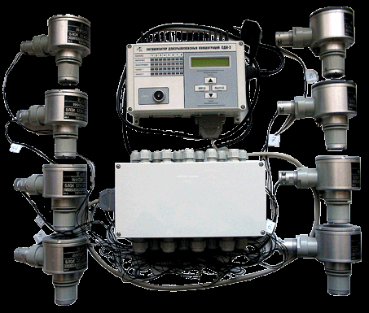
PROCESS safety DESIGN
Common Fire & Gas detection system deliverables are:
Design Specifications for Fire and Gas Detection System.
F&G Detection Layouts .
Fire Protection & Detection in Buildings .

Slide 95
Hazard and operability study-HAZOP
HAZOP is a systematic study which identify deviations and their causes from intended design.
The study uses a guideword approach and a “brainstorming” technique on the basis of System HAZOP, where the process or utility system configuration.
The study is performed on any P&I diagram where the contractor is in charge for the design of controls or shut down.
The study is conducted by a HAZOP Leader, with a team of experts in several key areas, which possibly includes members from the Site as well as the project team. Owner is request to participate.
Licensors attendance to the HAZOP is an optional scope of work as per Licensors Engineering Agreements.
A HAZOP Report collects the recommendations. After the issue of the report, actions are put in place to verify the implementation of the recommendations.

Slide 96
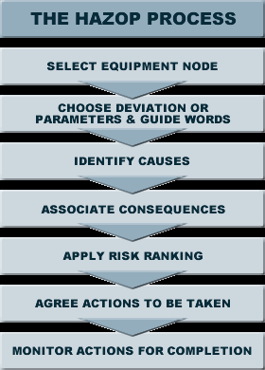
HAZOP
After the issue of the HAZOP deliverable report actions are ensured to verify the implementation of the recommendations, by reviewing the subsequent issue of the documentation. The study starts as following documentation is available
Plot Plan(s)
Process Flow Diagrams(s).
A complete set of second issue of P&ID.
Process Specifications.
Equipment Process Data Sheets
Material Safety Data Sheets.
Hazardous area classification.
Line Classification Lists.
Instrument Trip Descriptions.
Electrical one line diagrams
Materials of Construction Diagrams

Slide 97

Hazop communication
HAZOP recommendations will be included in the EPC Inquiring Package and will be duly considered in the Cost Estimate. It will be EPC Contractor responsibility to implement such HAZOP recommendations into the design of the facility.

Slide 98
Hazardous Material Safety Data Sheets
Material Safety Data Sheets (MSDS) are data sheets to provide vital information on health and physical hazards of all processed materials and chemicals on the projects.
Contents of the MSDS are:
Full physical and chemical data on the substance.
Average or range of composition, in the case of the a mixture.
Toxicological (i.e., physiological effects).
Flammability data.
Internationally recognized exposure limits for the substance.
Precautions to be taken when storing and handling the substance.
First aid and medical treatment to be undertaken on emergency.
Disposal Procedures

Slide 99
Hazop-Responsibilities
The Process Design Safety coordinator is in charge of:
Issue of issue/verification of deliverables.
Coordination of HAZOP study.
The following are the responsibilities of specialists:
All discipline specialists to implement the recommendations relevant to their discipline.
Fire fighting specialist prepare Fire Protection deliverables and Fire and Gas deliverables.
Process Manager is in charge of:
Coordination of collection of Hazardous Material Information Table.
Supervision of implementation of reviews recommendations.
Control of Fire Fighting deliverables.
The EHS Manager is charge of:
Planning of audit.
Monitoring reviews, studies and general philosophies considered HSE-sensitive.
Conduct Audits

Slide 100
MATERIALS selection
Requirements Compliance
Any impact on materials selection coming from standards and regulation are highlighted and taken into account by the Process Coordinator.
Audits check compliance with regulations and standards.
Management of risk
Results are shared with the Project Management.
Document is audited.
Fire proofing
Passive fire protection system is a system that performs its function without relying on the requirement of activation of any device.

Slide 101
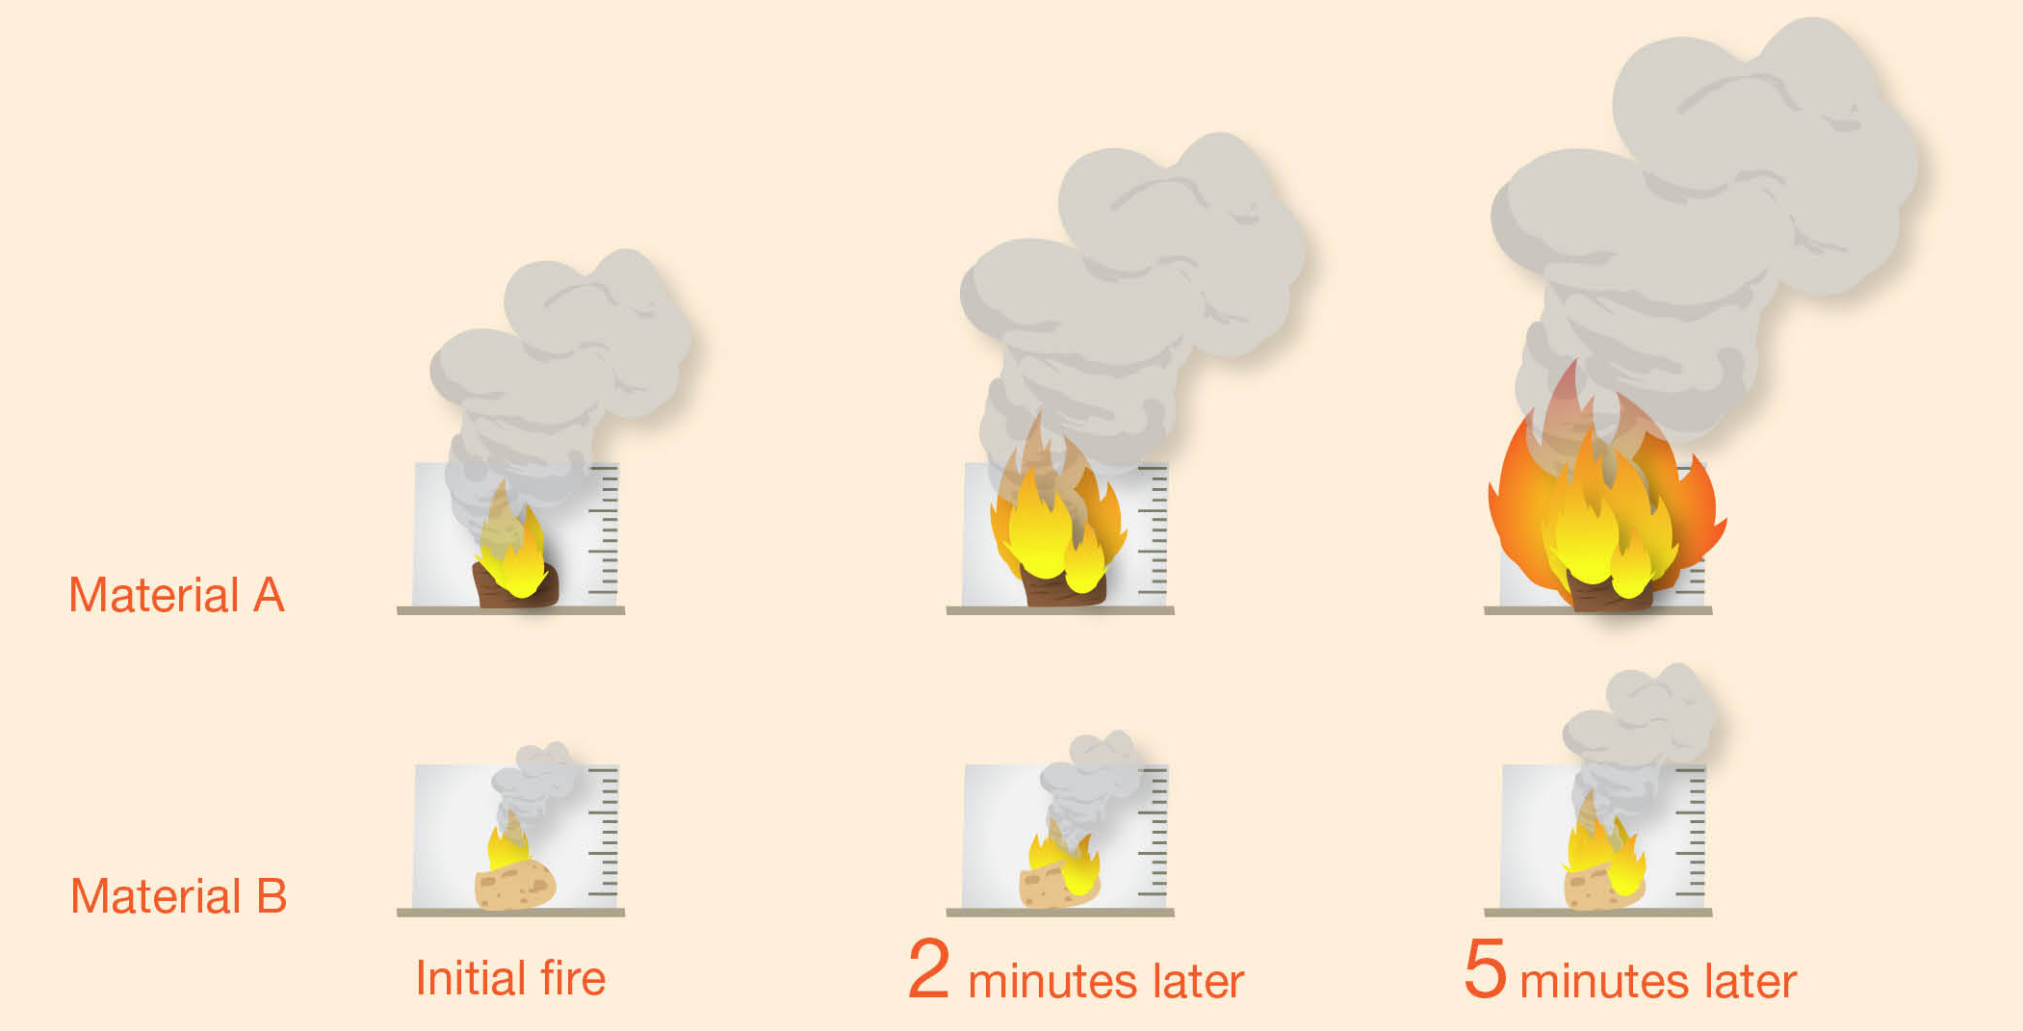
MATERIALS selection
Common Fire proofing deliverables are listed here below:
Fireproofing General Criteria
Fireproofing Specification and Data Sheets
Fireproofing Zones Drawings

Slide 102
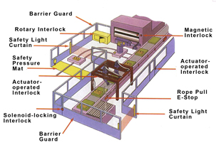
EQUIPMENT, PIPING AND MACHINERY DESIGN
Consider the following criteria or requirements during design stage;
Human Machine interface
Intrinsic safety
Noise reduction
Heat and thermal hazards
Machine guarding
Electrical safety

Slide 103
HEATERS, FLARES, STACK AND INCINERATORS DESIGN
Compliance with requirements
Requirements regarding air emissions should follow as per Environmental Design Philosophy
Calculation of all significant pollutant emissions, properly classified and detailed specification of the proper mitigation interventions eventually necessary in comparison with the Ecological Codes and the measures issued by Environmental Protection agencies
Management of risk
The risk related to heaters, flares and stack are assessed

Slide 104
HEATERS, FLARES, STACK AND INCINERATORS DESIGN
Flare Load summary
The flare load summary is an estimation of continuous flaring during normal operation, start up and shut down and maximum emergency cumulative flare loads from the plant including rate, composition, temperature and maximum allowable back pressure.
The summary is provided in Basic design phase and updated in the FEED phase. Main implications are highlighted and discussed with Project Management. The execution of the activity is checked.
Flare load summary outputs are:
Stack emission.
Specification for Heaters.

Slide 105
POLLUTION CONTROL FACILITIES DESIGN
Antipollution facilities are:
Sewer system.
Waste Water treatment
Requirements Compliance
Requirements and standards references and EIA recommendations are taken into account by a dedicated project role/service and included in Project Specifications. The following sections outline the requirements of the expected antipollution facilities.

Slide 106
POLLUTION CONTROL FACILITIES DESIGN
Sewer system
Effluents from oily sewer, storm runoff from the build-up area are discharged to off- plot treatment facilities.
Effluent Inventory
The inventory identifies and describes waste effluents (gaseous, liquid and solid).
The deliverables where information is available are following:
Chemical Consumption Summary per each Process Unit .
Effluent List per each Process Unit .
Material balance
Air Effluent Emission Study .

Slide 107
ELECTRICAL AND INSTRUMENTATION SYSTEM DESIGN
Hazardous Area Classification:
The Hazardous Area Classification is a systematic identification of hazardous area to assure that all electrical equipment and subsequent installation will be suitable for the hazard classification designated for its location.
The classification evaluates the sources of flammable products and the extension of their spread to define the profile of the hazardous area.
The deliverables are the following:
Item list for Area Classification
Hazardous are classification drawings

Slide 108
IMPLEMENTATION AND MONITORING - PROCUREMENT
All Suppliers/Vendors are responsible for forwarding activity related with their supply and are requested to be in compliance with contract requirements, NECL expectations, site rules and practices with reference to EHS.
Suppliers’ EHS System
Expectations and requirements are communicated to suppliers during the bidding phase.
Suppliers are assessed and evaluated by Project service/role on:
Ability to conform to EHS requirements in all phase of the supply, from occupational health and Safety of the working process, to final product and packaging.
EHS management capability and performances.
Staff and resources to fulfil EHS requirements.
A EHS plan, consistent with EHS requirements, is required to detail arrangements for the management of EHS.

Slide 109
IMPLEMENTATION AND MONITORING - PROCUREMENT
Contract Requirements
EHS function support procurement department in preparation of contracts of supplies.
Contracts include provisions that:
Highlight the EHS responsibilities of the supplier.
Specify requirements for effective audit, inspection and investigation programs
Terminate the contract if the supplier or its personnel fail to maintain EHS Standards required under the contract, and/or there is a risk of imminent hazard or serious injury caused by failure to remedy any unsafe practices or conditions identified.

Slide 110
The end

