Slide 1

ESG INDUCTION TRAINING
S.Annamalai, Head- ESG

Slide 2
What is ESG?
ESG represents the company’s efforts to systematically assess, manage, and monitor risks of material potential impact to the strategic and financial decisions of the company.
The term ESG is often used as a synonym for sustainability, CSR, public relations, social investment, or environmental compliance. While some of these elements may factor into an ESG program, at the center of ESG is the management of risk and the preservation of shareholder value.

Slide 3
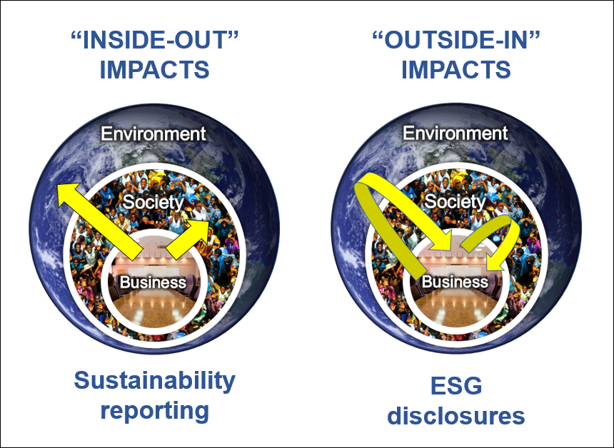
Sustainability vs ESG

Slide 4
Three categories of ESG
The “E” captures energy efficiencies, carbon footprints, greenhouse gas emissions, deforestation, biodiversity, climate change and pollution mitigation, waste management and water usage.
The “S” covers labor standards, wages and benefits, workplace and board diversity, racial justice, pay equity, human rights, talent management, community relations, privacy and data protection, health and safety, supply-chain management and other human capital and social justice issues.
The “G” covers the governing of the “E” and the “S” categories—corporate board composition and structure, strategic sustainability oversight and compliance, executive compensation, political contributions and lobbying, and bribery and corruption.

Slide 5
Introduction
ESG Is beneficial ? Workable? Profitable?
ESG an accounting and reporting framework having the 3 P’s as its components – PEOPLE, PLANET AND PROFITS
PLANET
PROFIT
PEOPLE

Slide 6
Benefits of ESG improvements:
Revenue growth
Competitive advantage
Cost reductions
Access to capital
Innovate with suppliers
Risk reduction and resilience
Enabler of corporate purpose
Impact beyond the business

Slide 7
Objectives
ESG is about the ability to create & sustain long-term value in a rapidly changing world, and managing the risks & opportunities associated with these changes.

Slide 8
SCOPE AND CONCERNS OF ESG
ENVIRONMENTAL | SOCIAL | GOVERNANCE
Greenhouse Gas (CHG) Emissions | Social Well-Being, Health, Security and Safety | Business Ethics and Ethical Standards
Climate Change | Working Conditions | Composition of Board, Board Process, Diversity and Governance
Water Management | Employee benefits | Structures of Board Committees
Recycling Process | Gender Diversity and Inclusion | Risk Management Systems
Deforestation | Respect of Human Rights | Stakeholder engagement
Emergency Preparedness and Disaster Management | Impact on Local communities | Anti-Corruption and Anti Bribery policies
Notes:
Strategic sourcing and investment in energy-efficient technologies.
Sourcing renewable energy and investing in on-site renewable energy generation.

Slide 9
Targets
Reducing greenhouse gas emissions
Investing in renewable energy
Conserving water and resources
Reducing waste.
Promoting diversity and inclusion.
Upholding human rights and labor standards:
Ensuring ethical business practices
Notes:
Strategic sourcing and investment in energy-efficient technologies.
Sourcing renewable energy and investing in on-site renewable energy generation.

Slide 10
Key ESG Legislative Requirements
In India, ESG (Environmental, Social, and Governance) legal requirements are primarily governed by the Securities and Exchange Board of India (SEBI)
Applicable regulations, including the Companies Act 2013 and the Listing Obligations and Disclosure Requirements, which mandate certain ESG disclosures for listed companies.
Focusing on environmental impact, social responsibility, and corporate governance practices; there is no single dedicated ESG law, but rather a framework built across different regulations.

Slide 11
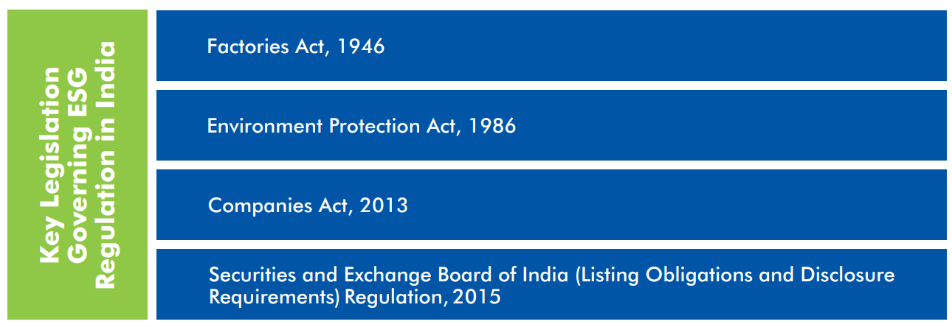
Key ESG Legislative Requirements

Slide 12
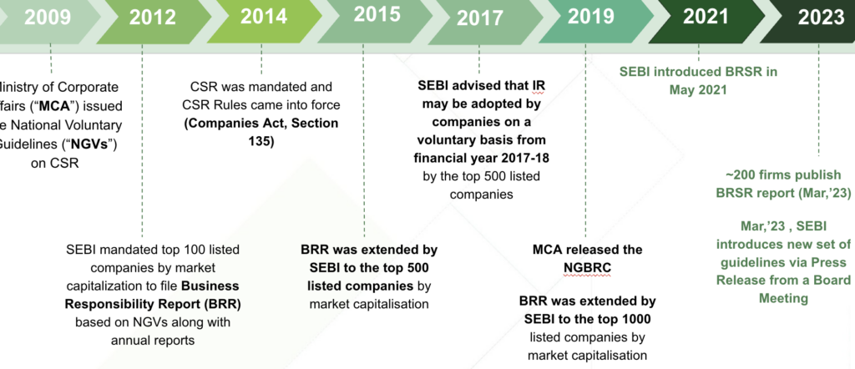
History of ESG in India

Slide 13

Global ESG Scores-2023
U.S.A. ranks 39 with a score of 75.91 India ranks 112 with a score of 63.45 (up 9 places from rank 121 in 2021)

Slide 14
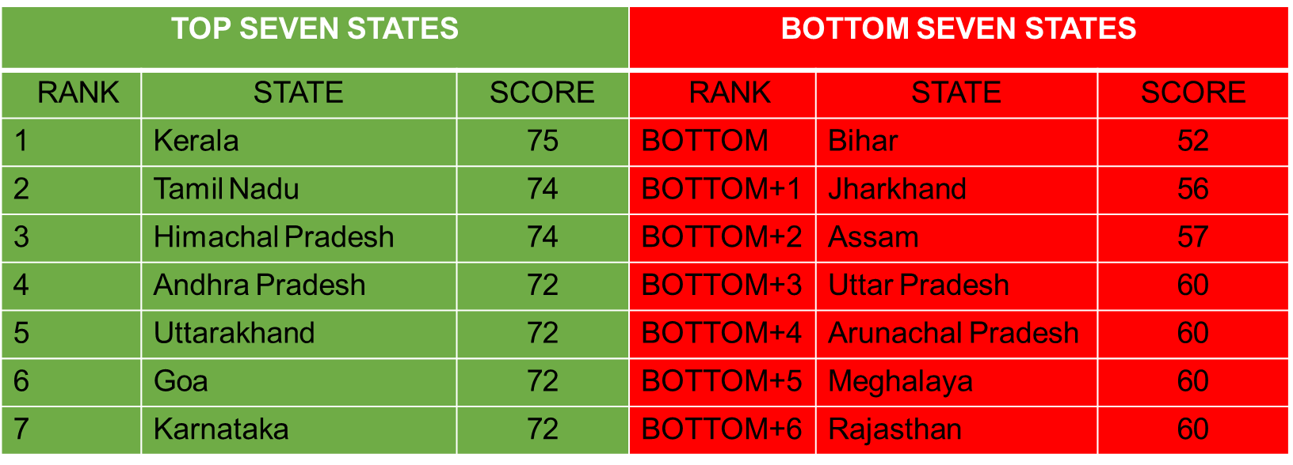
Statewide ESG Scores 2023

Slide 15
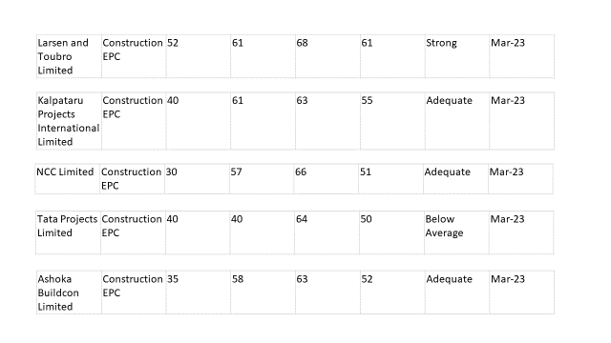
Top Engineering & Construction Indian Companies ESG Scores 2023

Slide 16
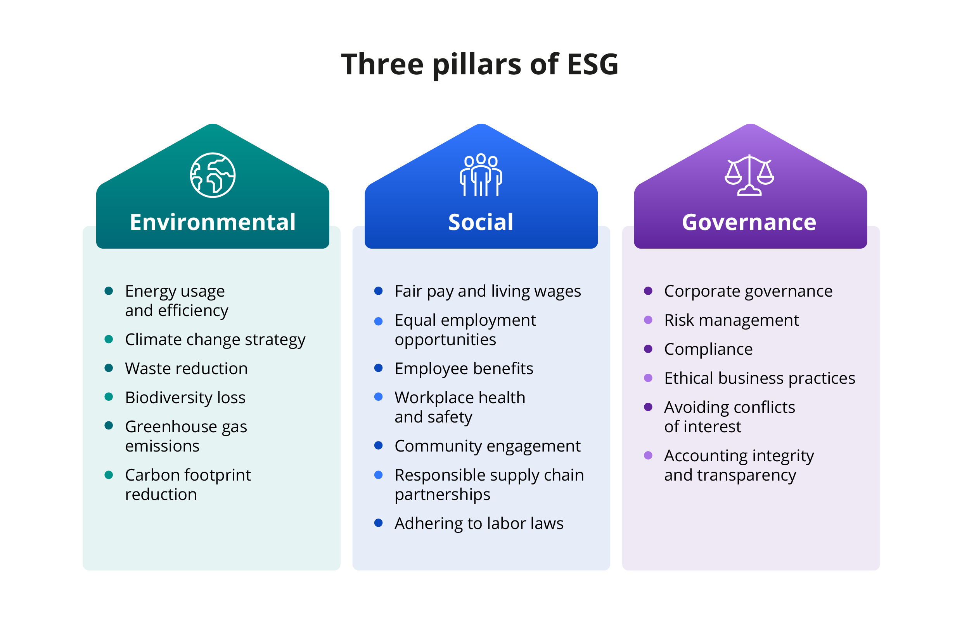
The Environmental Pillar of corporate sustainability reflects a company's commitment to minimizing waste and its carbon footprint.

Slide 17
Environmental Aspects in ESG
Pillar 1
Reduce waste
Recycling
Save water
Save electricity
Use Alternate energy sources
Reuse everyday items
Save fuel and reduce emission
Plantations
Adopting eco-friendly practices can often be more cost-effective, drawing in and benefiting consumers who prefer environmentally conscious products and services.
Notes:
Strategic sourcing and investment in energy-efficient technologies.
Sourcing renewable energy and investing in on-site renewable energy generation.

Slide 18

Reduce greenhouse gas (GHG) emissions
Identify and implement GHG reduction opportunities.
Energy Efficiency
Renewable Energy
Supply Chain
Waste Reduction and Diversion Strategies
Reduce Methane Emissions
Increase Fuel Efficiency in Transportation and Logistics

Slide 19
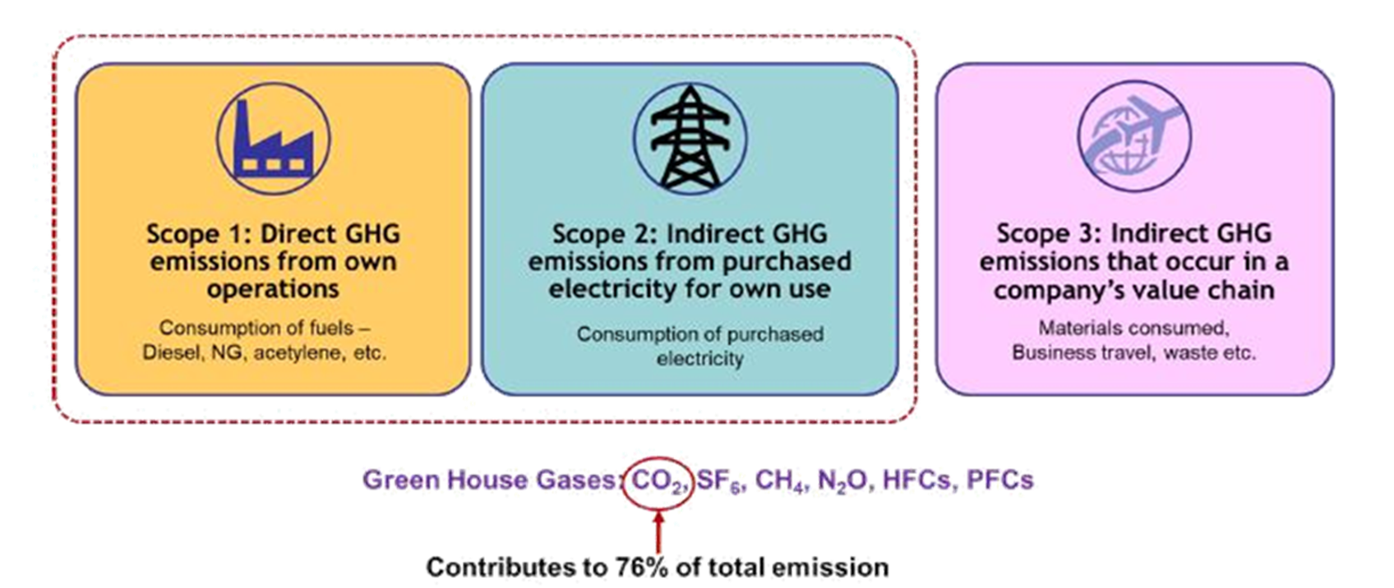
GHG Emission Control
Notes:
Strategic sourcing and investment in energy-efficient technologies.
Sourcing renewable energy and investing in on-site renewable energy generation.

Slide 20
Life Cycle Assessment (LCA)
An LCA can be used to calculate environmental impact and performance.
Design: what changes can we make to the product to lessen its environmental impact?
Purchasing: which product has the least environmental impact?
Marketing: is this product “greener” than that of the competitors?
Benchmarking: how’s our company doing compared to all the others in our industry?
Tracking: how’s our environmental performance doing this year compared with previous years?
Policy: What initiatives will help improve overall environmental outcomes?
Notes:
How well the executive management and board of directors consider the interests of the company's stakeholders
Whether the company is transparent and honest about its financial reporting
Whether board members act in the best interests of stockholders and avoid conflicts of interest
Whether the company's executive compensation is reasonable
Whether the company involves a wide range of stakeholders in goal-setting to ensure goals are realistic and align with stakeholder priorities
Whether the company is committed to sustainability and social responsibility, which can increase employee Whether the company is run responsibly and transparently to reduce risk and protect investors
motivation and engagement
Whether the company examines each component of its risk management in detail to understand how they impact the company and its stakeholder

Slide 21
Social Factors in ESG
Pillar 2
Human rights and equity
Labor practices/ Health & Safety
Diversity, equity, and inclusion (DE&I)
Community engagement
Product safety
Philanthropy
Social factors in environmental, social, and governance (ESG) are the ways a company's operations impact society and how it promotes social responsibility and inclusion: workplace diversity and inclusion, employee well-being, community engagement, supply chain practices, and overall impact on society.
Notes:
How a company treats people, including employees, customers, partners, and other stakeholders
How a company treats its employees, including working conditions, fair pay, and supply chain practices
How a company creates an inclusive workplace where all employees feel supported and engaged
: How a company interacts with the local community
How a company ensures the safety of its products
How a company contributes to the community

Slide 22
The Role of Social Factors in ESG Strategy
Incorporating social factors in a company’s ESG strategy can significantly impact its reputation and stakeholder relationships.
These factors enable companies to address social issues, build trust with stakeholders, and maintain a positive corporate reputation.
For instance, IT departments can play a key role in addressing social factors by utilizing technology ethically and responsibly, safeguarding sensitive data, and fostering digital inclusion.
Pillar 2
Notes:
How a company treats people, including employees, customers, partners, and other stakeholders
How a company treats its employees, including working conditions, fair pay, and supply chain practices
How a company creates an inclusive workplace where all employees feel supported and engaged
: How a company interacts with the local community
How a company ensures the safety of its products
How a company contributes to the community

Slide 23

Quantifying Social Data
Quantifying social data for ESG purposes presents several challenges, including the lack of a reliable measurement standard and the difficulty in capturing qualitative aspects of social factors.
The subjective and qualitative nature of social data makes it difficult to measure and quantify, leading to complexities in assessing the full impact of social initiatives.
But don’t let that stop you, as these initiatives tend to sort themselves out as they progress over time.

Slide 24

Growing importance of social factors reflected in ESG investing?
The importance of social factors in ESG investing is increasingly evident, as stakeholders push for higher expectations and a shift from environmental to social priorities.
Stakeholders are increasingly looking for companies to demonstrate their commitment to social responsibility, and ESG investing is a way to do this.
Companies are expected to take into account the social impact of their decisions, and investors are increasingly demanding this.

Slide 25
Governance Factors in ESG
Pillar 3
Executive management
Financial reporting
Board members engagement
Stakeholder relations
Employee engagement
Reduced risk
Systemic risk management
Governance is the set of rules, processes, and practices by which a company is directed and managed.
Notes:
How well the executive management and board of directors consider the interests of the company's stakeholders
Whether the company is transparent and honest about its financial reporting
Whether board members act in the best interests of stockholders and avoid conflicts of interest
Whether the company's executive compensation is reasonable
Whether the company involves a wide range of stakeholders in goal-setting to ensure goals are realistic and align with stakeholder priorities
Whether the company is committed to sustainability and social responsibility, which can increase employee Whether the company is run responsibly and transparently to reduce risk and protect investors
motivation and engagement
Whether the company examines each component of its risk management in detail to understand how they impact the company and its stakeholder

Slide 26

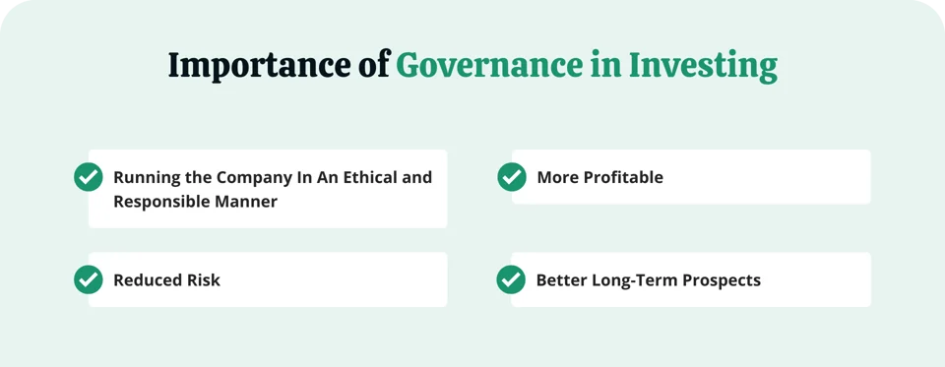
Importance of Governance

Slide 27
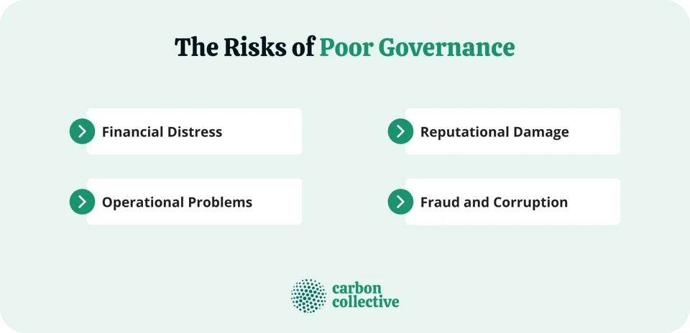
Risks of Poor Governance

Slide 28
Stakeholder Model
The stakeholder model of governance is based on the idea that a company is responsible to all of its stakeholders, not just its shareholders.
This means that the company should consider the interests of employees, customers, suppliers, and the community when making decisions.
The stakeholder model of governance is often thought to lead to better long-term decision-making, as it considers all stakeholders' interests.

Slide 29
Shareholder Model
The shareholder governance model is based on the idea that a company's only responsibility is to its shareholders.
This means that the company should make decisions in the best interests of shareholders, even if it means sacrificing the interests of other stakeholders.
The shareholder model of governance is often thought to lead to short-term decision-making. Companies may sacrifice long-term projects that would benefit all stakeholders to generate returns for shareholders in the short term.

Slide 30
Running the Company In An Ethical and Responsible Manner
First, it ensures that the company is operating in a way aligned with the investors' values. For example, suppose an investor is looking to invest in a company committed to environmental sustainability. In that case, they will want to ensure that the company is indeed following through on its commitment.
Second, it helps to protect the interests of shareholders. This is because good governance practices help ensure that a company is making decisions in the best interests of its shareholders.
Good governance helps ensure that companies are run ethically and responsibly, which is important for both investors and society.

Slide 31
Reduced Risk
Good governance can help to reduce risk by ensuring that companies are run responsibly and transparently. This can help to protect investors from potential losses.
For example, if a company is considering a major acquisition, good governance practices would require the board of directors to consider how the acquisition would impact the shareholders.
This type of transparency can help to reduce the risk of investors being surprised by negative news.

Slide 32
More Profitable
Good governance can also lead to increased profitability. This is because companies with good governance practices are better able to manage risk and avoid financial problems.
In addition, good governance can help to improve a company's relationships with its stakeholders. For example, a company with good governance practices is more likely to have a good relationship with its employees, leading to increased productivity.
Finally, good governance can help to attract and retain investors. This is because investors are more likely to invest in a company that they believe is well-managed and run responsibly.

Slide 33
Long-Term Prospects
Good governance can also lead to improved long-term prospects for a company. This is because companies with good governance practices are more likely to make decisions that are in the best interests of the shareholders.
For example, a company with good governance practices is more likely to invest in long-term projects that will generate returns for shareholders over time.

Slide 34
Conclusion
When it comes to ESG investing, governance is an important factor. Good governance practices can help to improve a company's financial performance and long-term prospects while also protecting investors from potential risks.
When assessing a company, consider the quality of its governance to make an informed investment decision.
Carbon Collective focuses its portfolio on companies aiming to solve climate change that function with a high level of governance. Carbon Collective firmly believes these ethically-governed companies are positioned for substantial long-term growth.

Slide 35
ESG Reporting In India
Business Responsibility and Sustainability Reporting (BRSR)
The Securities and Exchange Board of India (SEBI) requires the top 1,000 companies in India by market capitalization to publish BRSR reports annually. The BRSR includes a company's ESG performance and initiatives.
ESG rating providers
SEBI has allowed ESG rating providers to register under CRA norms, which helps reduce greenwashing risks and encourages transparency.
Government initiatives
The Indian government promotes ESG through guidelines like the India ESG Framework and by promoting green bonds for sustainable projects.
Collaborative efforts
Investors can integrate ESG factors into their decision-making, and consumers can support companies with strong ESG credentials.

Slide 36

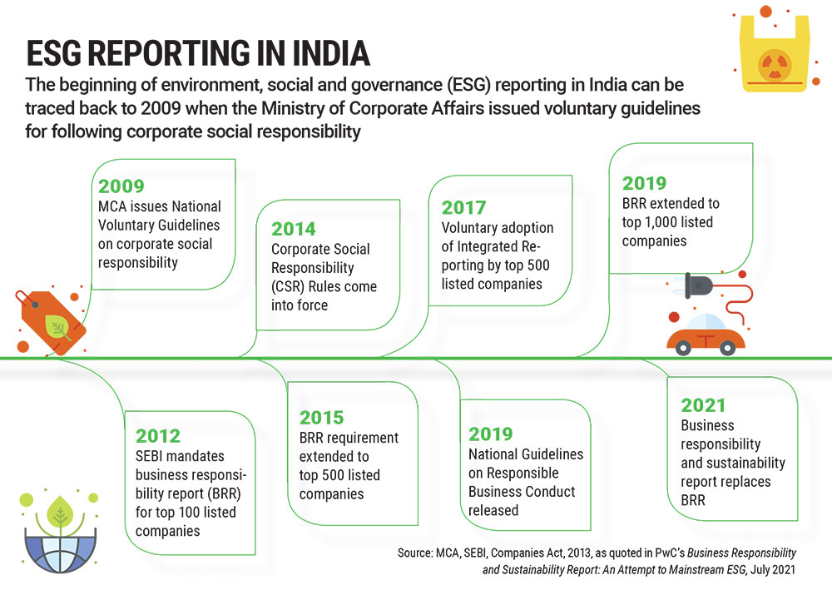

Slide 37
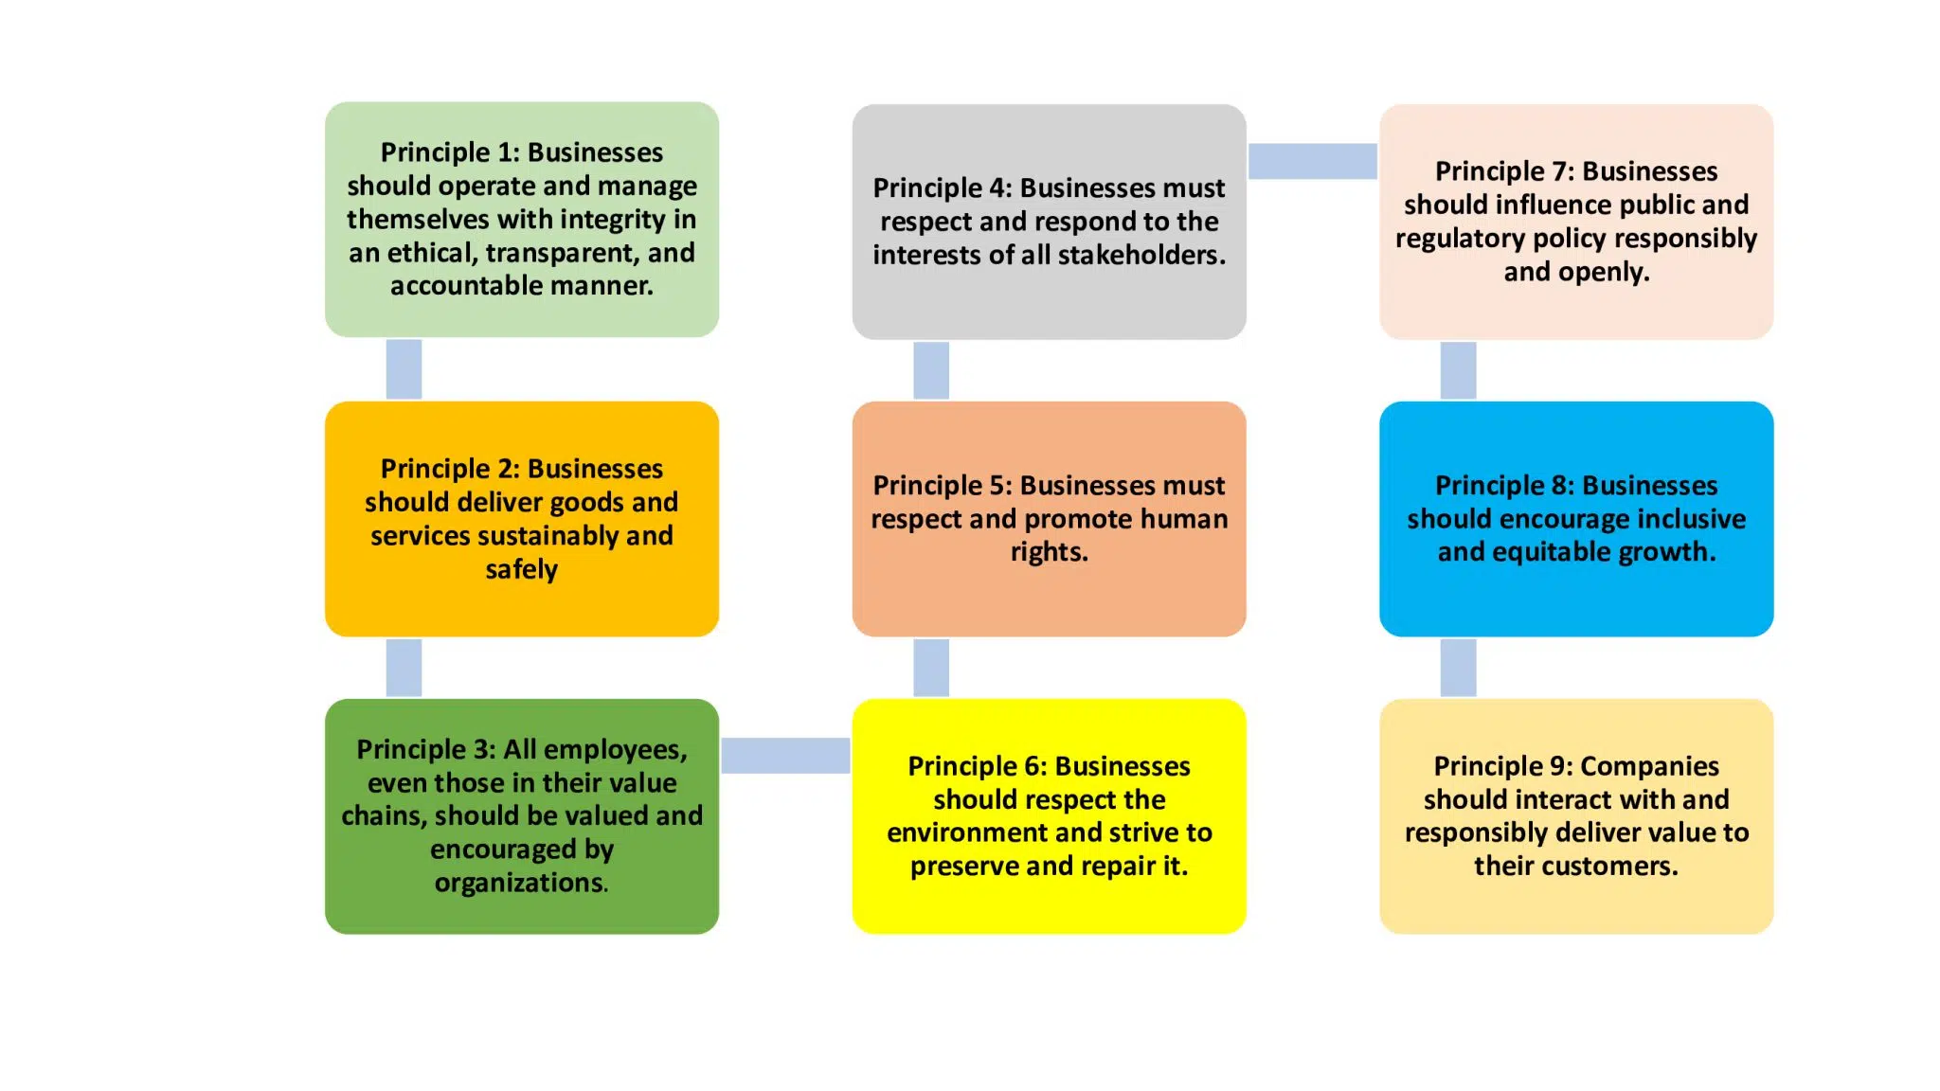
Governing Principles of NGRBC
Notes:
Principle 1: Businesses should operate and manage themselves with integrity in an ethical, transparent, and accountable manner.
Principle 2: Businesses should deliver goods and services sustainably and safely.
Principle 3: All employees, even those in their value chains, should be valued and encouraged by organizations.
Principle 4: Businesses must respect and respond to the interests of all stakeholders.
Principle 5: Businesses must respect and promote human rights.
Principle 6: Businesses should respect the environment and strive to preserve and repair it.
Principle 7: Businesses should influence public and regulatory policy responsibly and openly.
Principle 8: Businesses should encourage inclusive and equitable growth.
Principle 9: Companies should interact with and responsibly deliver value to their customers.

Slide 38

17 SDG’S OF BRSR

Slide 39

17 SDG’S SUB DIVISIONS

Slide 40
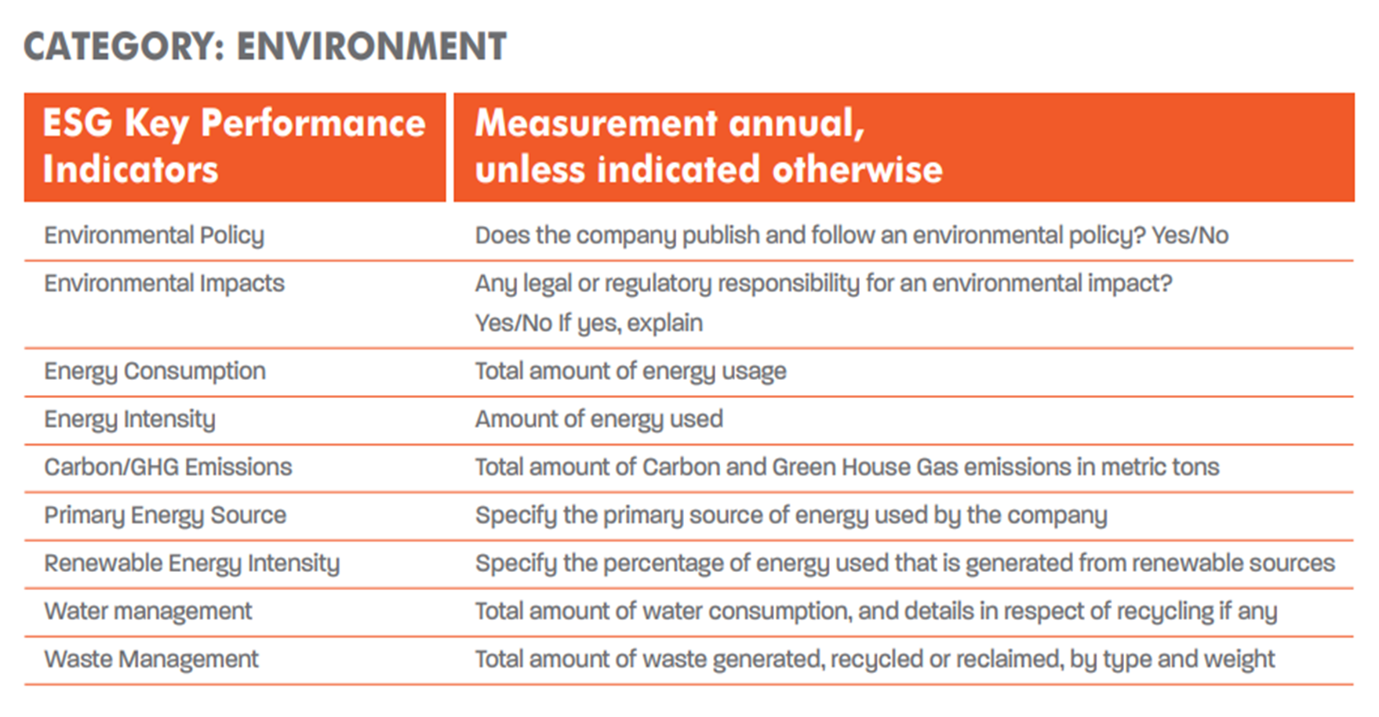
KPI & MEASUREMENTS

Slide 41
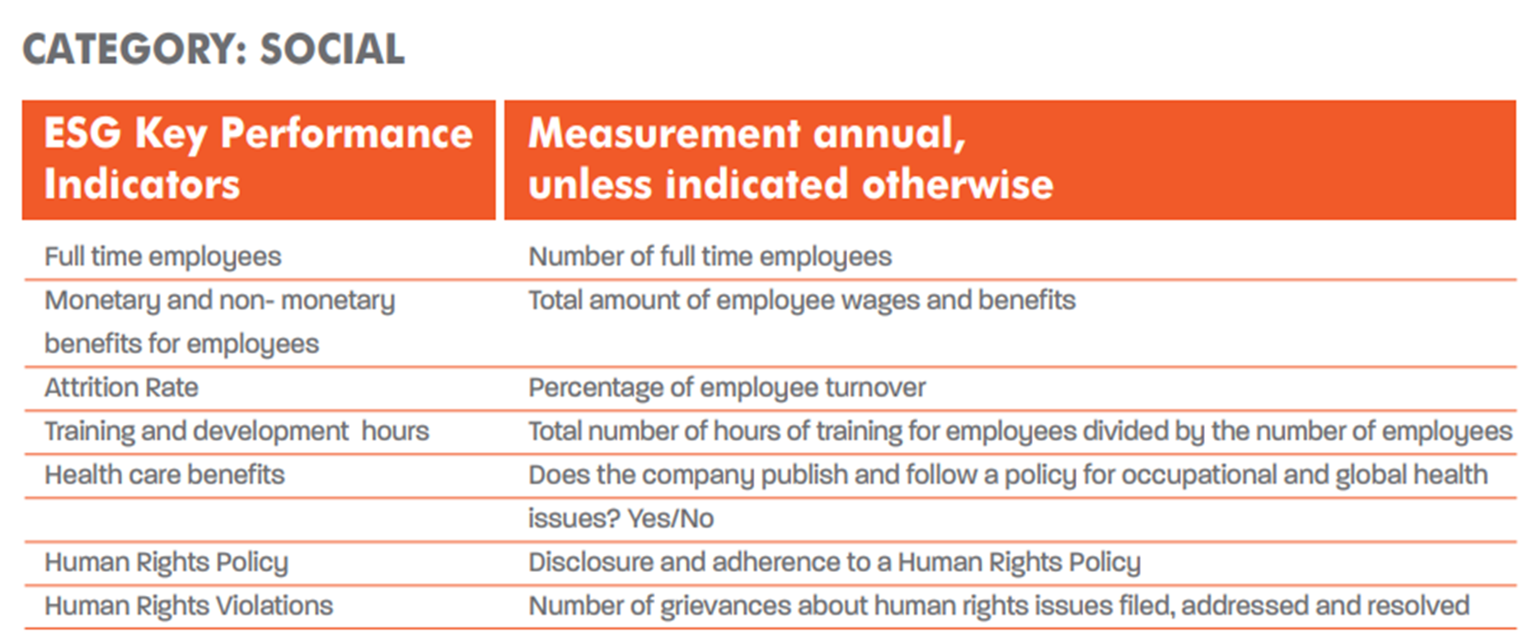
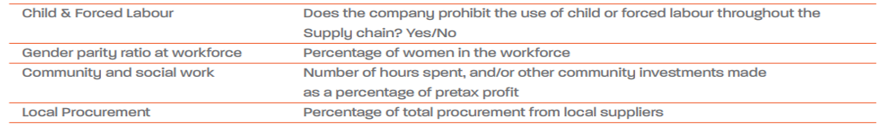
KPI & MEASUREMENTS

Slide 42
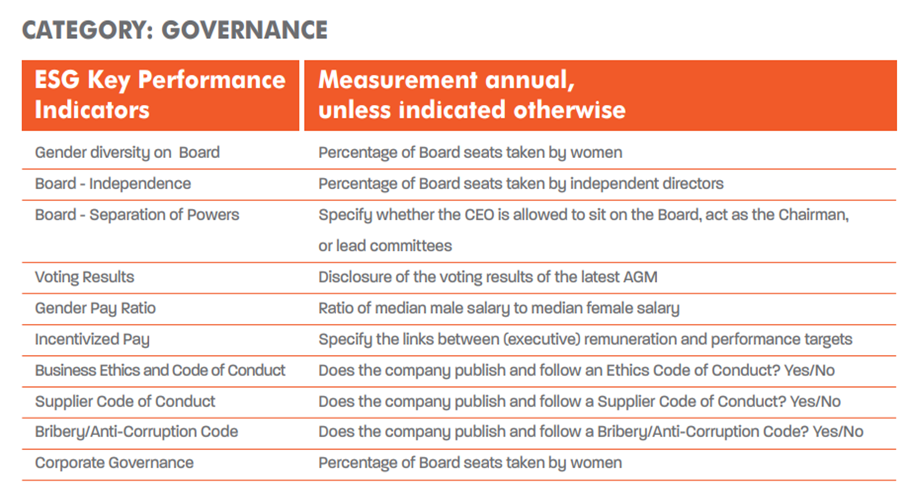
KPI & MEASUREMENTS

Slide 43
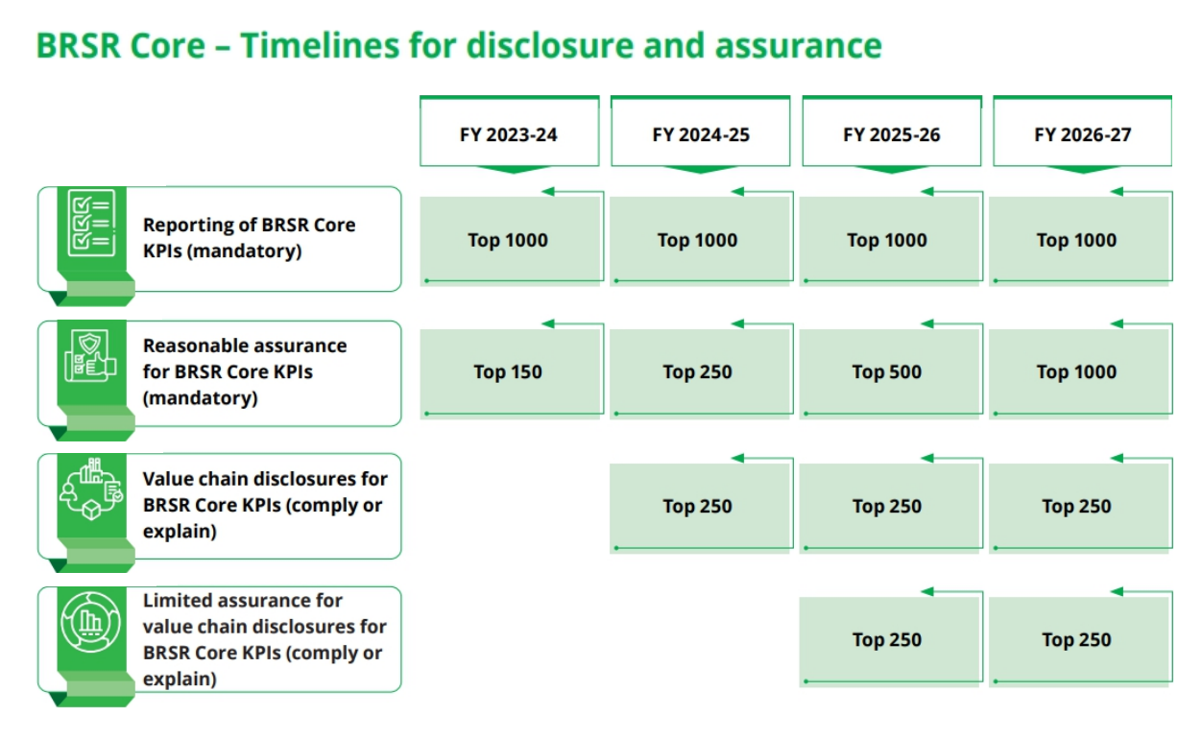
Large Image
Time Line

Slide 44
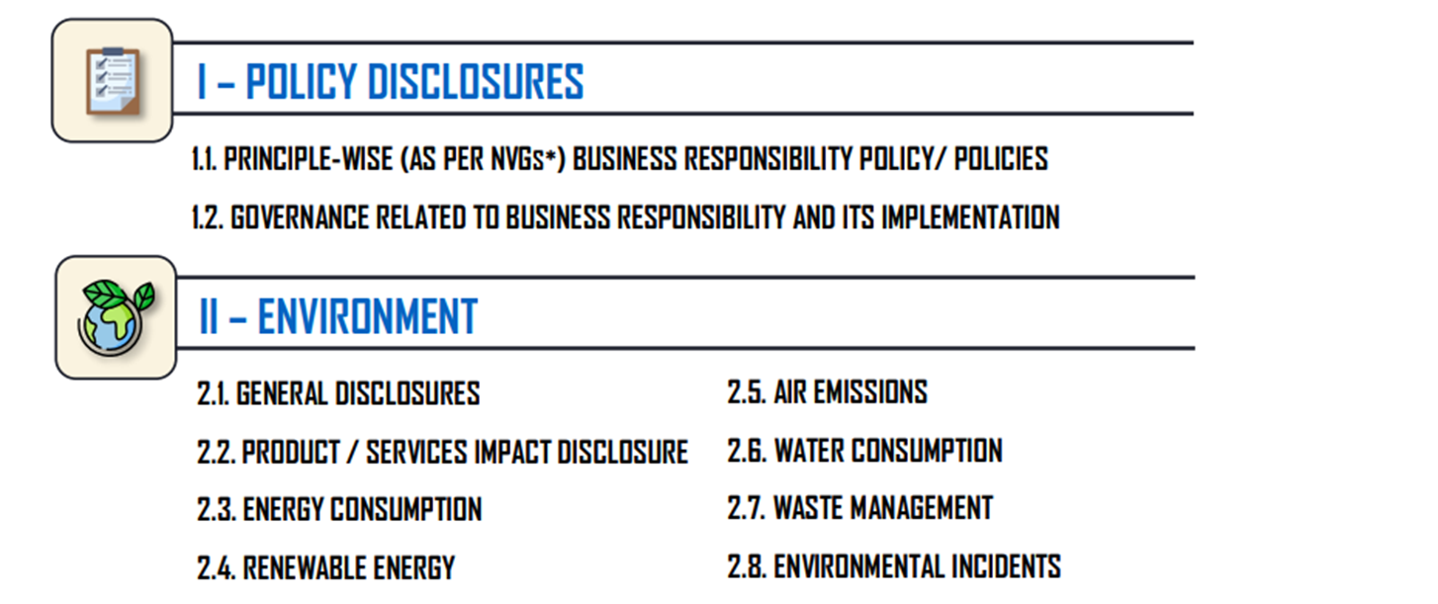
BRSR Reporting Topics

Slide 45
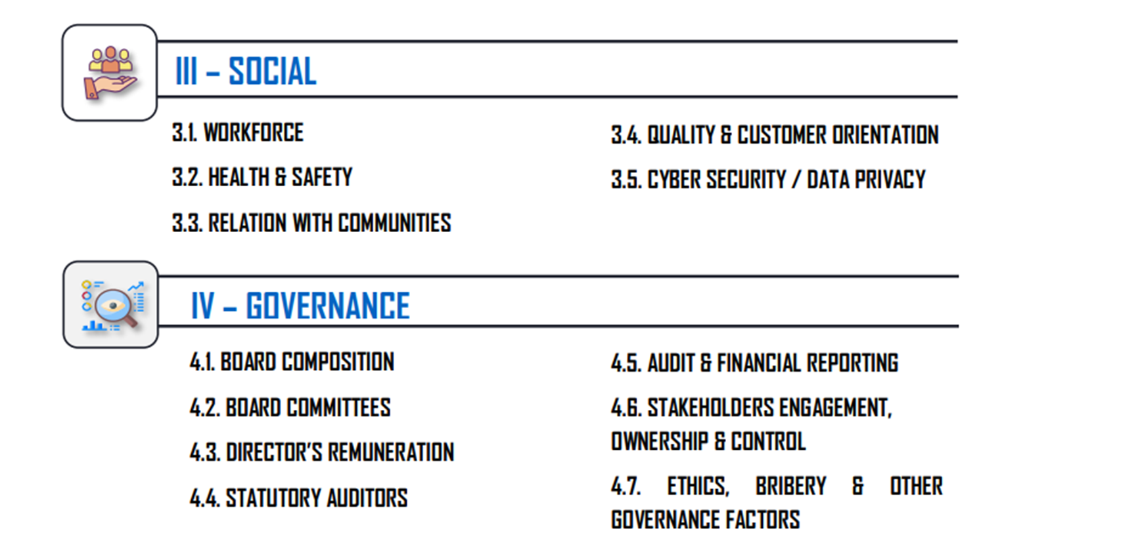
BRSR Reporting Topics

Slide 46
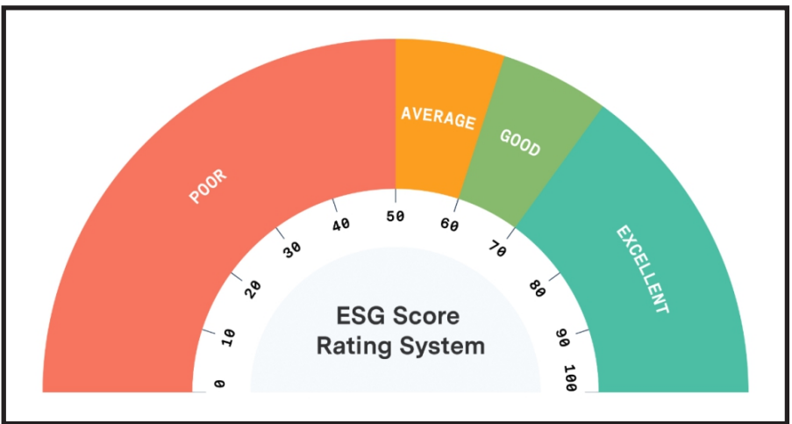
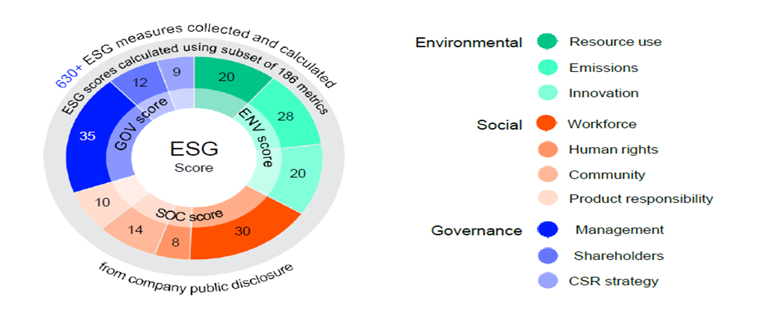
Large Image
ESG SCORING

Slide 47
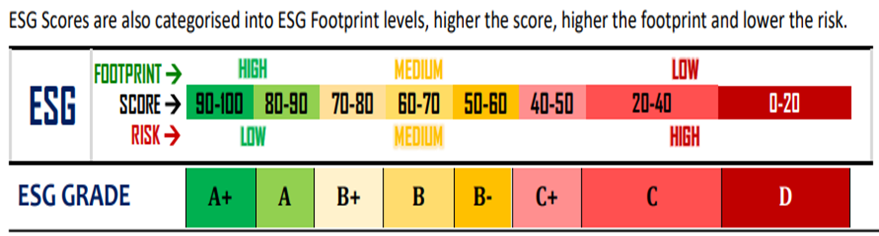
Foot print score vs Risk

Slide 48
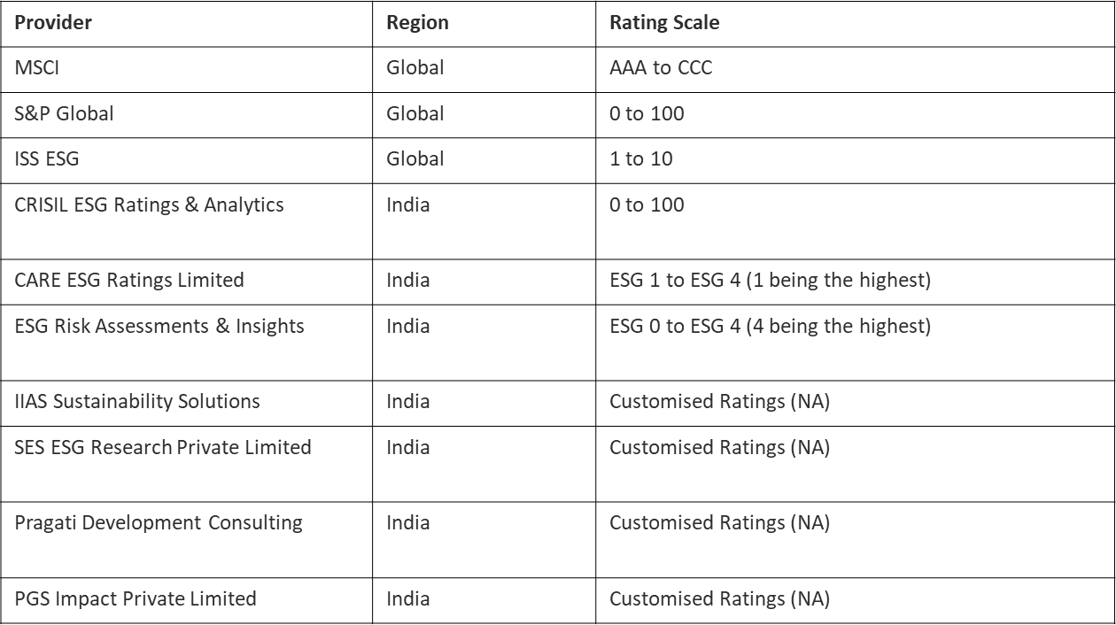
Rating Providers in India

Slide 49
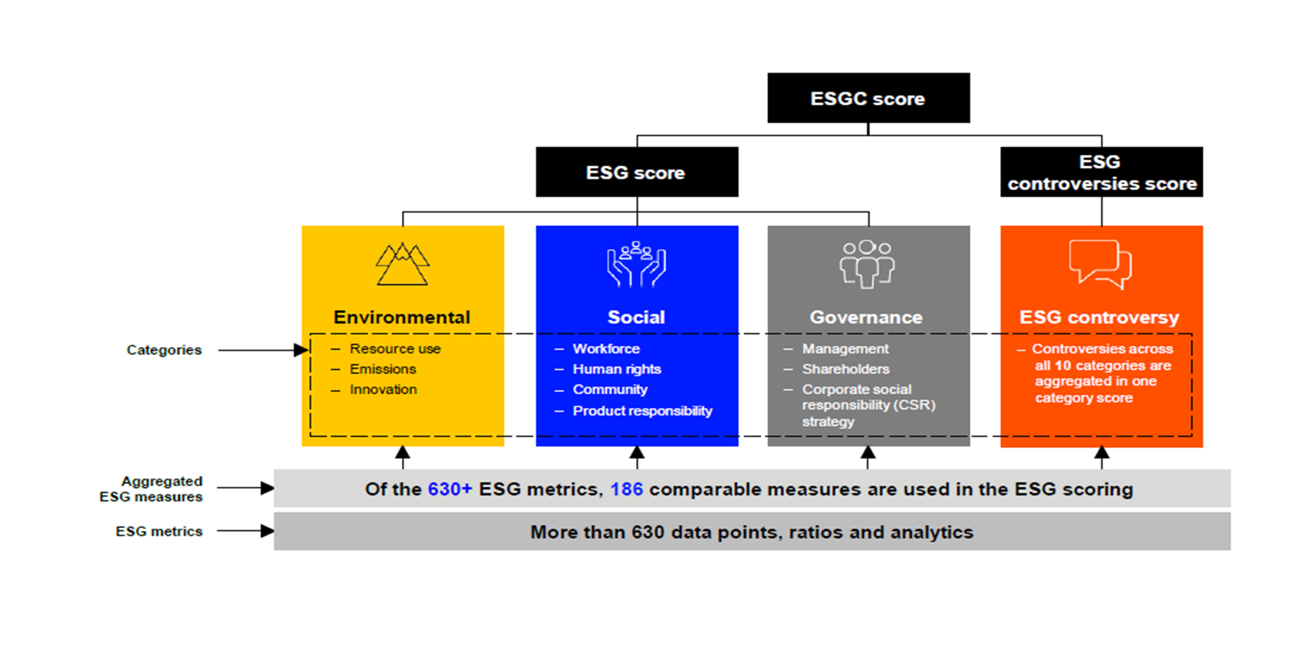
Large Image
ESG SCORING & CONTROVERSIES

Slide 50
Large Image
PROCESS OF ESG REPORTING
Strengthening ESG Factors as per SEBI guideline
Collect data’s from Projects
Generate report
Do internal Audit
Engage third party rating firms to assess our scores
Submit annual report (Financial & Non-Financial)
Report to SEBI (Mandatory or Voluntary)

Slide 51
Large Image
ESG Implementation at NECL
Policy & Procedure
HR Data on Employee engagement
Environmental Data
LCA & RA Data
Health & Safety Data
Waste management & Recycling Data
Data to ensure women empowerment, engaging all community
Alternate energy source options
Training Data
Customer, client & stakeholder engagement Data
Child labor & human rights Data
CSR & Management Inputs

Slide 52
THE END

